Slide 1


November 2018
ET Professional Monitors

Slide 2
Contents
Inflation | 3
Central Bank Omnipotence | 8
Trade and Tarifs | 13
US Fiscal Policy | 18
Credit Cycle | 23
Guide to Use | 28
Disclaimers | 31

Slide 3
Inflation Commentary
Attention to inflation narratives continued to wane in November as drumbeats for a slowing in the pace of Federal Reserve hikes became louder than discussion of continued wage inflation and price movements in emerging markets.
In our view, the core inflation narrative has effectively shifted to, “Input prices may be rising, but Fed won’t let asset prices fall like this.”
Of some interest, the largest single cluster – and a new one – is now a cluster focused on protests and shortages. These may not be familiar to all US readers, but are increasingly an issue in other regions.
This cluster and others seem to be telling stories of non-monetary causes for local inflation, especially issues like Brexit, tariffs, taxes and trade rules.
We observed no major changes in the usually negative sentiment around inflation, or in the fiat news / advocacy journalism language present in articles.

Slide 4
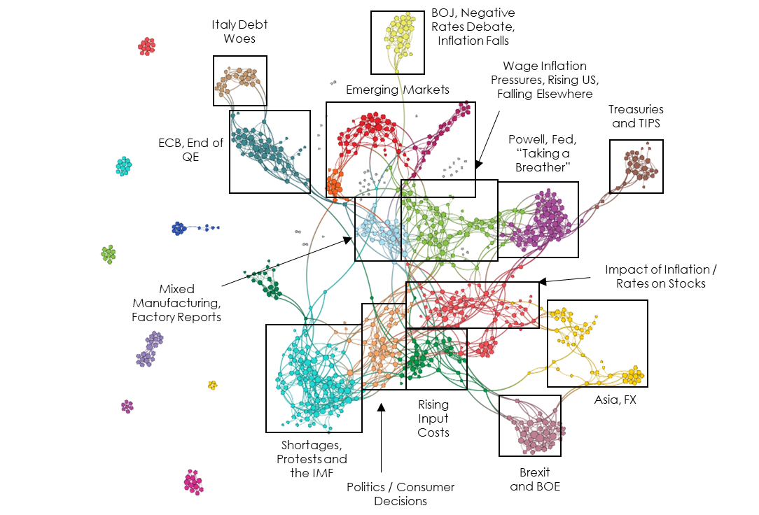
Inflation Network Map – November 2018

Slide 5
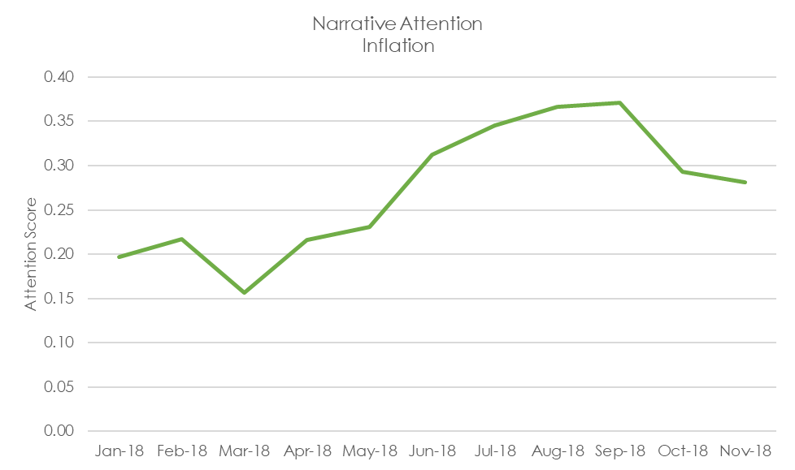
Inflation Attention Monitor – November 2018

Slide 6
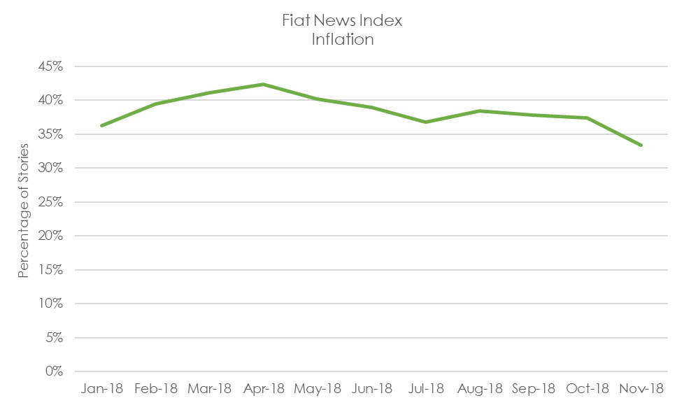
Inflation Fiat News Monitor – November 2018

Slide 7
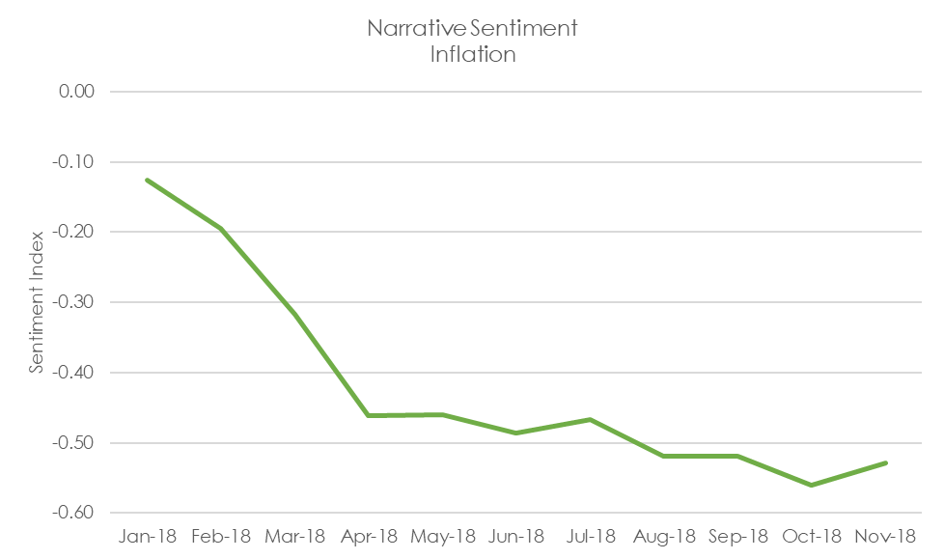
Inflation Sentiment Monitor – November 2018

Slide 8
Central Bank Omnipotence Commentary
While our slower smoothed measure has moved only slightly, our November point estimate for the attention around central bank omnipotence has spiked to the highest point in 2018.
Like the inflation narrative structure, we have observed a new center forming around the poor performance of financial markets and the expectation that central banks will adjust their policy to protect these markets. It’s early, but it is possible that we are seeing a resurgence of a central bank omnipotence narrative that has been dormant for some time.
We still note that inflation and the various risks to the European financial system remain very central to these articles as well. We have not, however, seen as prominent a “maybe ending QE in Europe isn’t such a good idea” narrative emerging there.

Slide 9
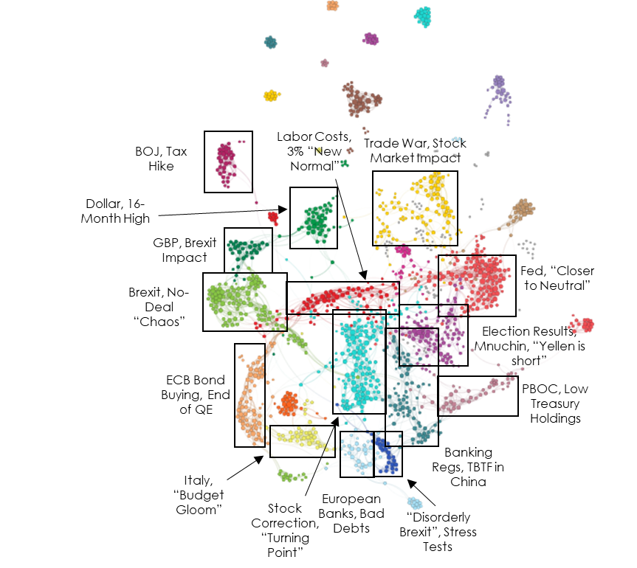
Central Bank Omnipotence Network Map – November 2018

Slide 10
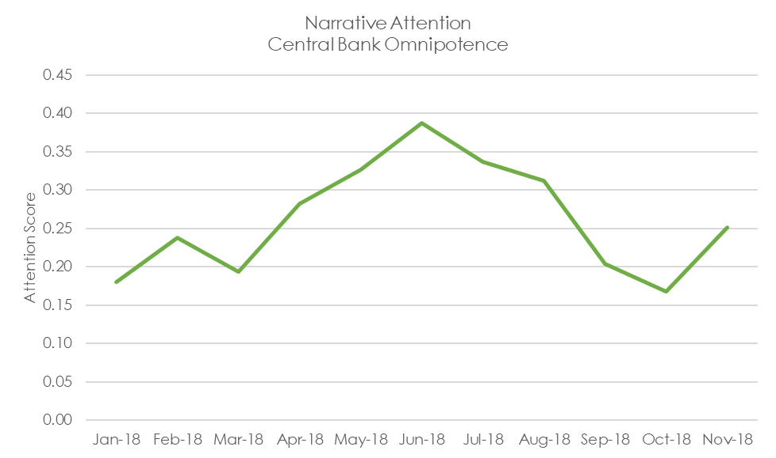
Central Bank Omnipotence Attention Monitor – November 2018

Slide 11
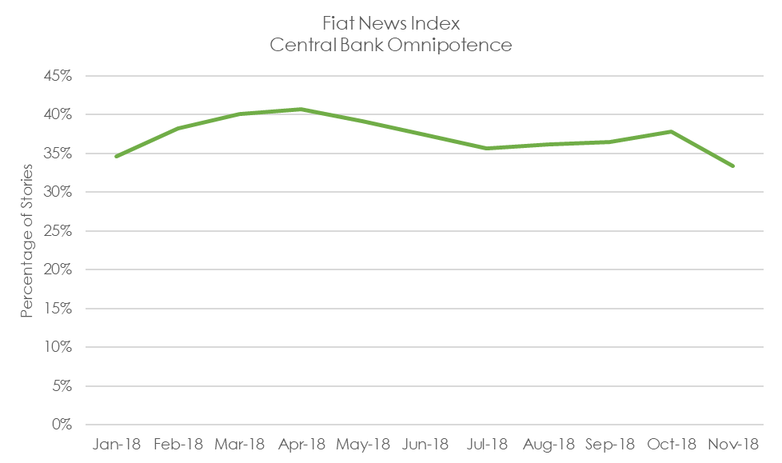
Central Bank Omnipotence Fiat News Monitor – November 2018

Slide 12
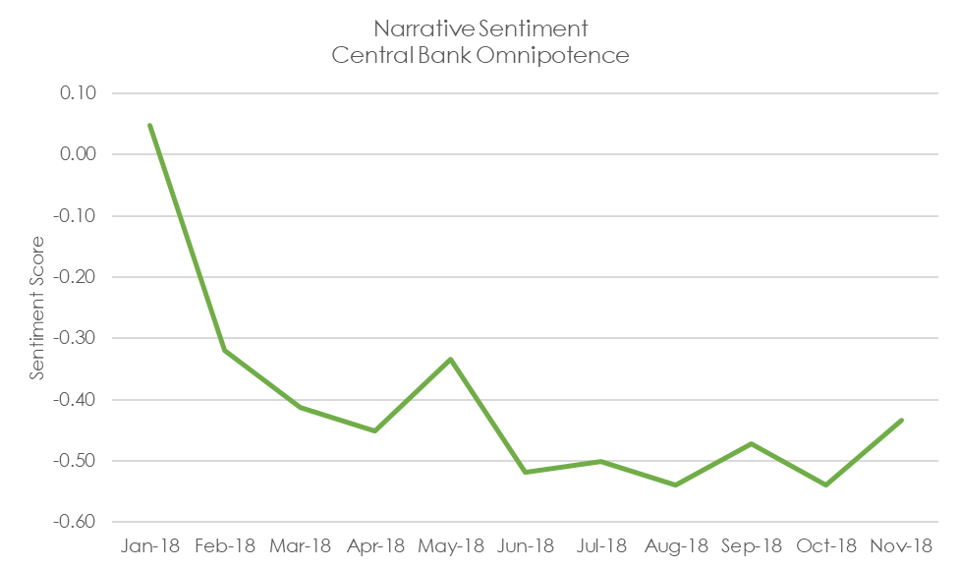
Central Bank Omnipotence Sentiment Monitor – November 2018

Slide 13
Trade and Tariffs Commentary
Thanks to a remarkably concentrated November point-in-time measure, our attention measure rose sharply.
There is now an emerging narrative around tariffs and trade: they are a national security issue. This has the potential to be a powerful switch in rhetoric, leveraging a meme with strong emotional content to attach tariffs to territorial conflicts, intellectual property disputes and cybersecurity concerns.
We would be very mindful of the ability for this pivot to sustain trade policy that might otherwise be unsustainable and unpopular.
While Brexit has obvious trade implications, it has been surprisingly undercovered as a trade issue. Outside of its impact on bank sustainability, it is currently almost completely divorced from any trade narratives and is not something we would expect to exert significant influence on ex-UK financial markets unless there is a material and surprising event.

Slide 14
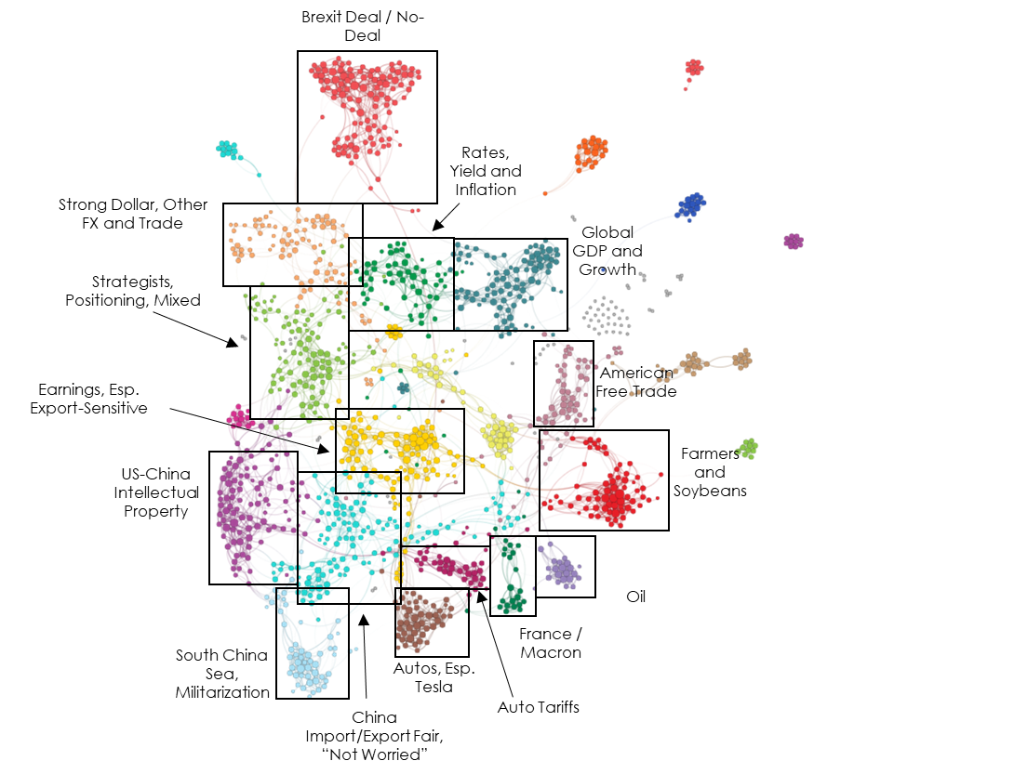
Trade and Tariffs Network Map – November 2018

Slide 15
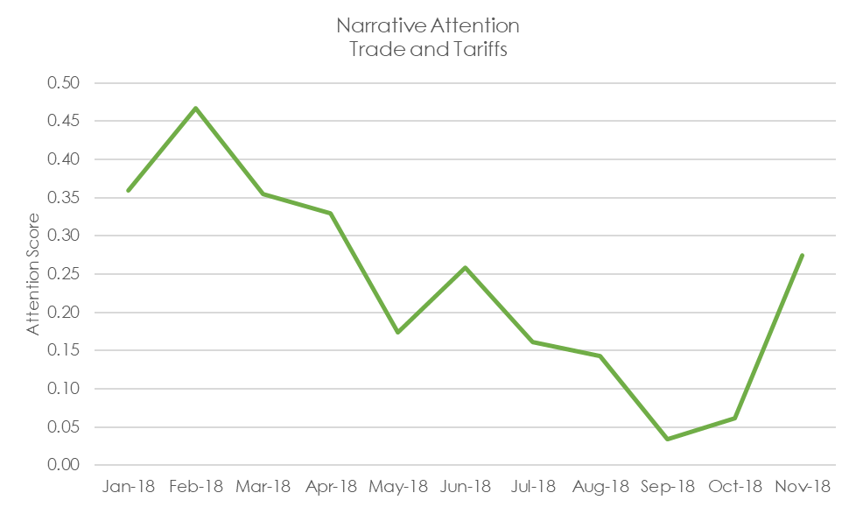
Trade and Tariffs Attention Monitor – November 2018

Slide 16
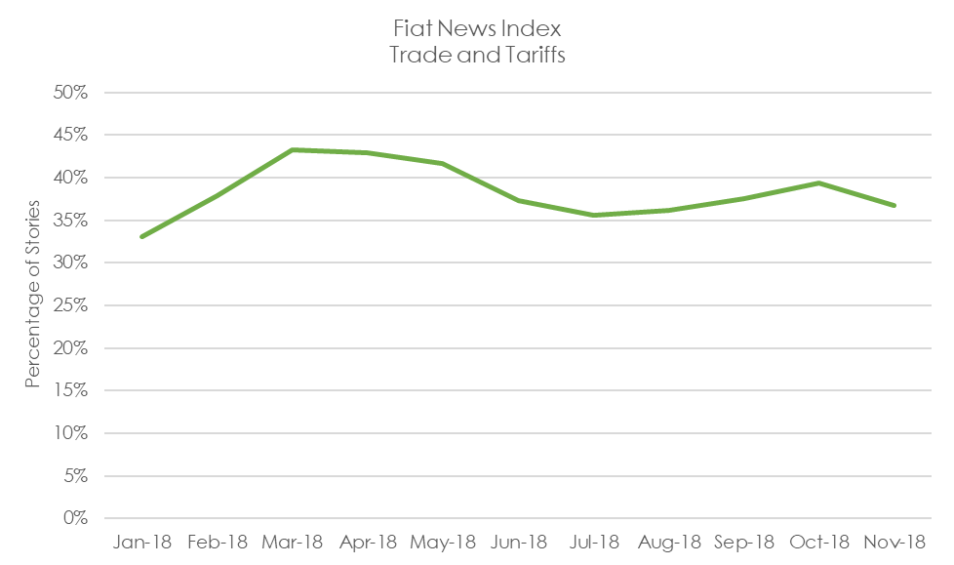
Trade and Tariffs Fiat News Monitor – November 2018

Slide 17
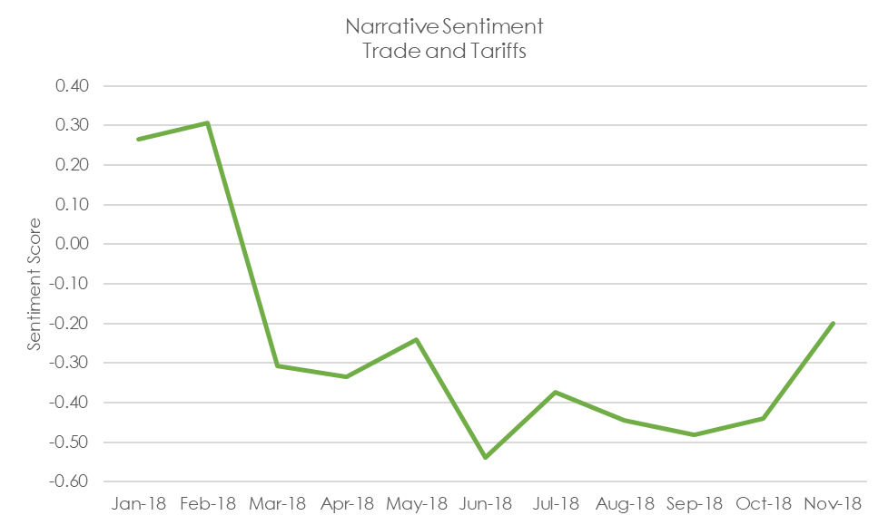
Trade and Tariffs Sentiment Monitor – November 2018

Slide 18
US Fiscal Policy Commentary
After the usual mid-term election narrative chatter, the importance placed on fiscal policy in the U.S. across media outlets continued to plummet in November.
Along with the drop in attention to any one narrative, advocacy journalism and fiat news measures continued to decline. Our general interpretation is that the topics have generally returned to ‘policy wonk’ status.
Sentiment on these topics has quickly returned to neutral levels, too as the wonks take back the baton from the more pointed advocates across news and ‘analysis’ journalism.
We still see and hear investment theses built around the notion of major fiscal policy shifts in the US. Those things may come to pass, but until the narrative becomes more widely accepted and promoted, we don’t think that these theses have legs.

Slide 19
US Fiscal Policy Network Map – November 2018

Slide 20
US Fiscal Policy Attention Monitor – November 2018

Slide 21
US Fiscal Policy Fiat News Monitor – November 2018

Slide 22
US Fiscal Policy Sentiment Monitor – November 2018

Slide 23
Credit Cycle Commentary
Our single point attention measure rose from floor levels in November, although our smoothed rolling measures have only moved slightly. The main cause appears to be significantly tighter and shared language across articles about fed activity and inflation, about bond funds and about leveraged loans and CLOs.
We’ve also seen “junk bond” take over from “high yield” as the top n-gram for some topics.
Sentiment, however, has rebounded back to normal levels for the topic. We don’t have a ready explanation for this, although many of our monitors took a downward turn during the election cycle.
We have also observed fiat news measures rising to unusual levels, even for a topic that is very often “explained” to readers. While on its own we don’t think this has much explanatory power, we do think it tends to be indicative of newly established or changing narratives, something we will be able to evaluate over the coming months.

Slide 24
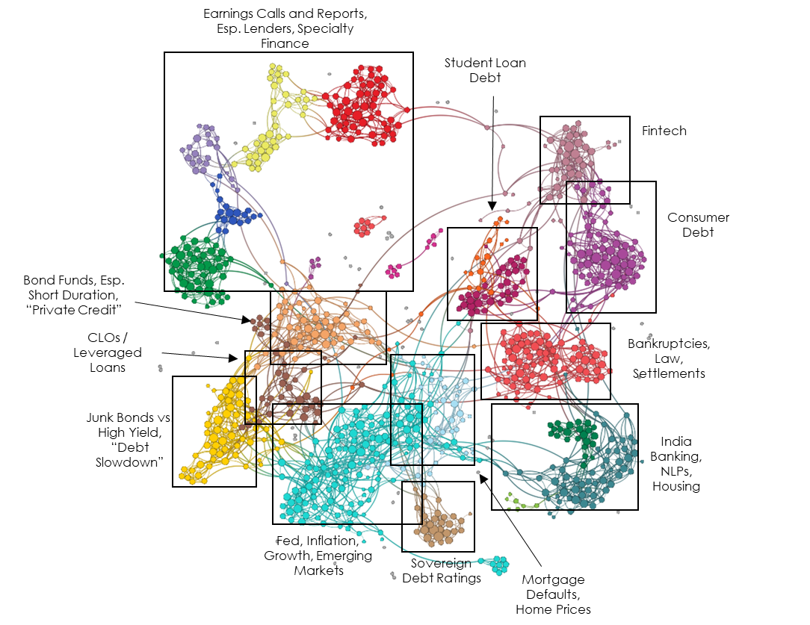
Credit Cycle Network Map – November 2018

Slide 25
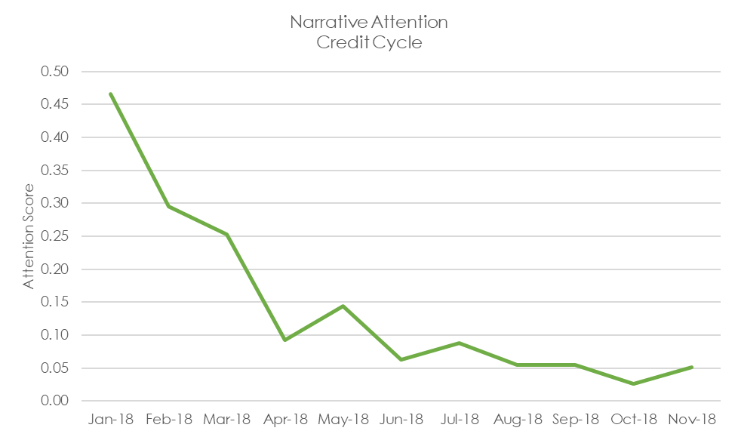
Credit Cycle Attention Monitor – November 2018

Slide 26
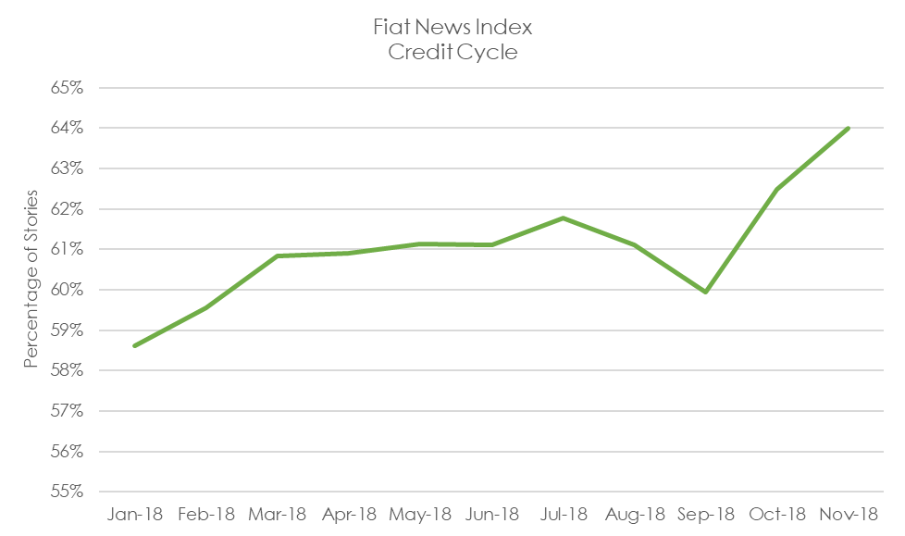
Credit Cycle Fiat News Monitor – November 2018

Slide 27
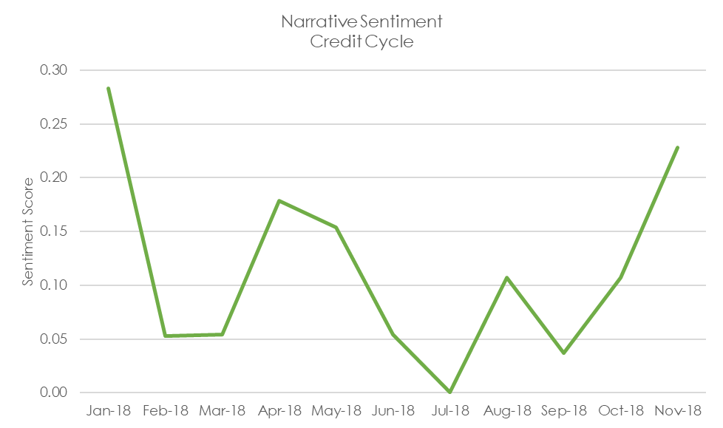
Credit Cycle Sentiment Monitor – November 2018

Slide 28
Text Analytics Background

Slide 29
How to Read a Network
Quid creates a visual map to represent the landscape. Example network: sized by degree, colored by cluster.

Slide 30
ET Professional Terminology
Attention is an Epsilon Theory-only measure which uses a Djikstra Algorithm to find the shortest distance between each node (article) pair, and measures the normalized harmonic centrality of the entire network of those pairs. Think of it as a measure of the similarity between all articles on a topic. It is measured between 0-1, and should not be compared between topics, which may be naturally more or less similar because of the nature of the topic as defined.
Sentiment is a Quid-based measure based on scores of the positive or negative characteristics of each n-gram (phrases, words, etc.). Our measure is calculating as (% net positive – % net negative) / (% either positive or negative).
Fiat News is an Epsilon Theory-only measure of the use of words or phrases which communicate assertions of casuality, value judgments or self-evidence (e.g. “obviously”). We use it to measure the aggregate tendency of articles to explain content, which can sometimes be related to periods of heightened narrative promotion.
Narrative Maps are Quid-driven content, but the categories and cluster titles are based on Epsilon Theory analysis of the underlying articles’ content and Quid-identified n-grams.

Slide 31
Disclaimers and Use
This analysis is prepared as general research and commentary, and is not a recommendation to buy or sell any security. It does not take into account individual facts and circumstances, and should be supplemented by additional such analysis to guide any investment decisions.
If you are an ET Professional Subscriber, you may use these slides for personal or commercial use in any client presentation at which the subscriber is present.
In those uses, you may modify the slides to use your branding and format, provided that Epsilon Theory and Quid are described as sources on those pages (footnotes are fine).
You may not distribute these slides publicly (e.g. on Social Media, on your website, etc.) without the permission of Epsilon Theory.

