Slide 1


May 2019
ET Professional Monitors

Slide 2
Contents
Inflation | 3
Central Bank Omnipotence | 10
Trade and Tariffs | 17
US Fiscal Policy | 24
Credit Cycle | 30
Guide to Use | 36
Disclaimers | 39

Slide 3
Inflation Commentary
Inflation attention rose somewhat in May, albeit in a less traditional way – price, wage and inflation language is making a return through 2020 election rhetoric.
The introduction of this language, mostly in relation to the health care, education cost and wage issues raised previously, has had some influence on financial media coverage, but remains very different from traditional inflation coverage. The result has been that cohesion of inflation narratives has fallen (i.e. there are multiple active weak narratives without any central influence).
The politically oriented inflation narratives are meaningfully more negative in tone than the usual macro / central bank coverage; the result has been a sharp drop from the already negative sentiment usually attached to this topic.
Our interpretation continues to be that there is not a meaningful short-term inflation narrative.

Slide 4
Inflation Network Map – May 2019

Slide 5
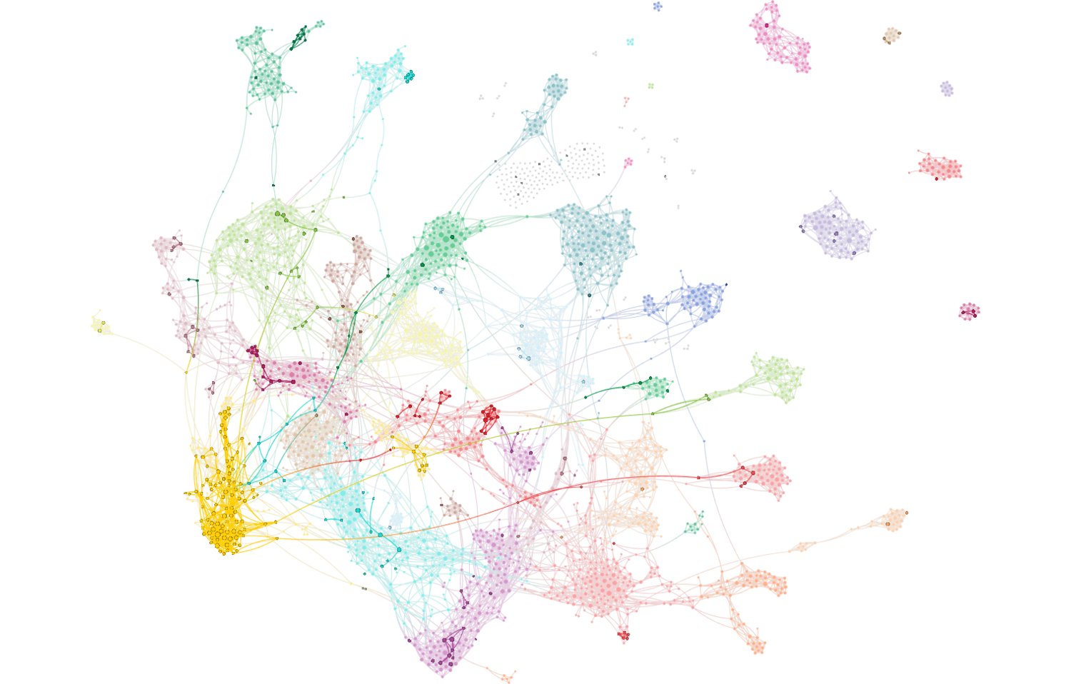
Inflation Attention – May 2019
Full network reflects all articles referencing stocks/equities. Bold-faced nodes represent articles discussing inflation, producer prices, wage pressures and costs.

Slide 6
Inflation Attention Monitor – May 2019

Slide 7
Inflation Cohesion Monitor – May 2019

Slide 8
Inflation Fiat News Monitor – May 2019

Slide 9
Inflation Sentiment Monitor – May 2019

Slide 10
Central Bank Omnipotence Commentary
Despite the shocking rise in Trade & Tariffs attention, attention to Central Bank Omnipotence remained constant in May.
Cohesion, on the other hand, fell sharply, as divergent views on appropriate fed policy emerged. The existence of an emerging “we must cut rates” narrative in response to weak May equity markets alone contributed significantly to this shift in cohesion.
While we still think the “Fed put is back” narrative is in place, it is now closely intertwined with the Trade and Tariffs issue – the “China Trade War” cluster of articles is the most central in the network graph!
  We think there is complacency around a narrative that the Fed will respond to trade/tariff concerns with a rate cut.
  Outside of the narrative but in our conversations with trade desks, we observe growing drumbeats around the conspiratorial view that the Trump administration is intentionally seeking to provoke a rate cut only in order to quickly resolve the trade disputes.
  Both observations indicate to us the continued presence of a Fed Put narrative.

Slide 11
Central Bank Omnipotence Network Map – May 2019

Slide 12
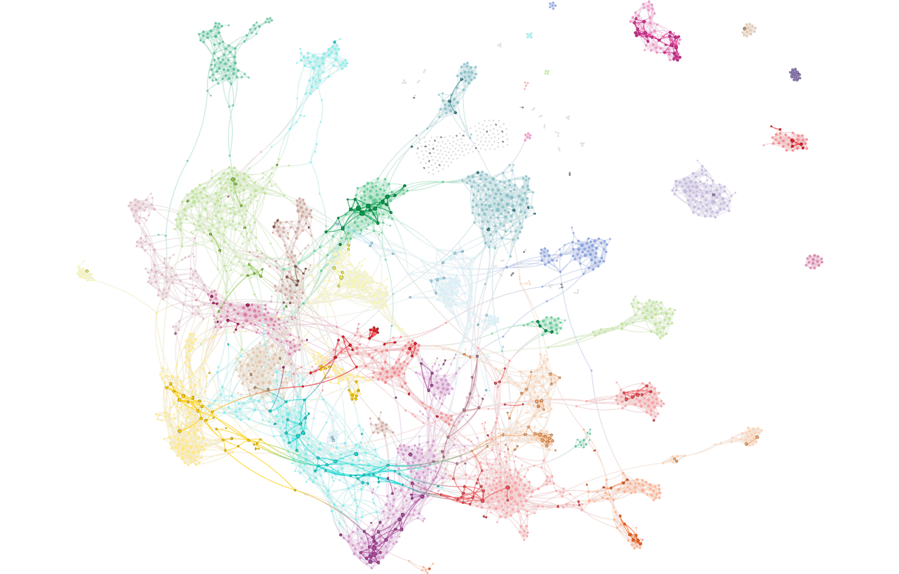
Central Bank Omnipotence Attention – May 2019
Full network reflects all articles referencing stocks/equities. Bold-faced nodes represent articles discussing the Fed, ECB, BOJ, BOE and other global central banking policy.

Slide 13
Central Bank Omnipotence Attention Monitor – May 2019

Slide 14
Central Bank Omnipotence Cohesion Monitor – May 2019

Slide 15
Central Bank Omnipotence Fiat News Monitor – May 2019

Slide 16
Central Bank Omnipotence Sentiment Monitor – May 2019

Slide 17
Trade and Tariffs Commentary
Consistent with our suspicions from our prior monitor report, attention to Trade and Tariffs narratives soared to their highest level since we began tracking the topic – nearly every article written about financial markets had some attachment to trade war discussions, whether as explanations for May returns or as an explanation of macro drivers.
The growth in attention, however, exceeded our expectations when President Trump doubled down on his threats with Mexico tariff rhetoric and when administration officials in both the US and China accelerated geopolitical and national security rhetoric.
This is no longer a complacent narrative structure.
It is also no longer a Game of Chicken. It is a geopolitical game in which the political outcomes may permit a lose/lose choice by both parties on trade.
Trade and Tariffs and Central Bank Omnipotence narratives are intertwined. This leads us to believe that the “Fed put” narrative structure is specifically complacent about a rate cut response to trade war concerns.

Slide 18
Trade and Tariffs Network Map – May 2019

Slide 19
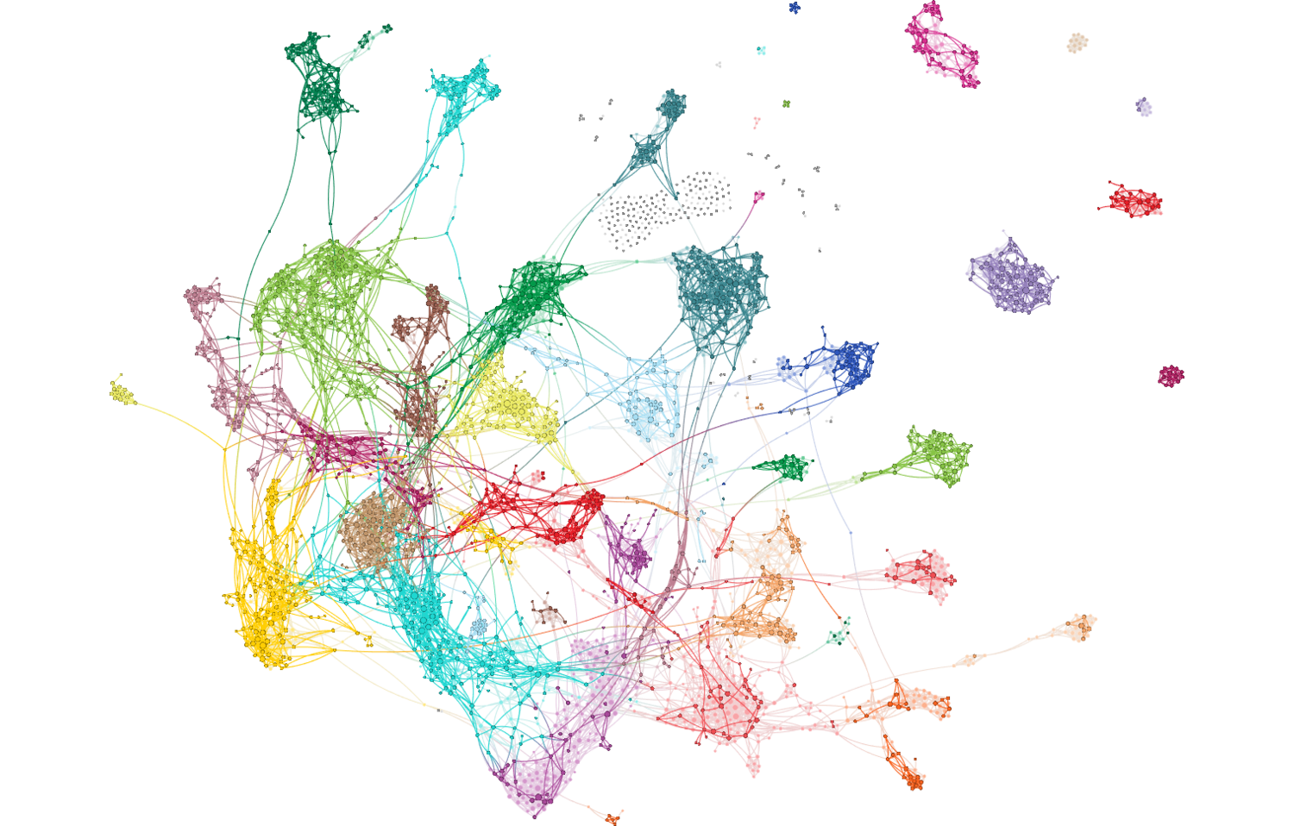
Trade and Tariffs Attention – May 2019
Full network reflects all articles referencing stocks/equities. Bold-faced nodes represent articles discussing trade, tariffs, duties and associated agreements and negotiations.
(Yes, this is the actual Attention Map for Trade & Tariffs in May, not just the map of all financial markets stories)

Slide 20
Trade and Tariffs Attention Monitor – May 2019

Slide 21
Trade and Tariffs Cohesion Monitor – May 2019

Slide 22
Trade and Tariffs Fiat News Monitor – May 2019

Slide 23
Trade and Tariffs Sentiment Monitor – May 2019

Slide 24
US Fiscal Policy Commentary
There is very little attention being paid to fiscal policy / budgetary topics, and practically no linguistic connection between them and financial markets narratives.
We expect this to increase as election politics spin into higher gear, but for now, our Fiat News measure has fallen and Cohesion remains at floor levels.
As with other topics, China trade war language was closely attached to fiscal policy discussions in May as well.
Student debt continues to exert significant and disproportionate gravity on the language used to discuss US budget and fiscal policy, joined by entitlement programs and the continued backdrop of Green New Deal and MMT chatter.

Slide 25
US Fiscal Policy Network Map – May 2019

Slide 26
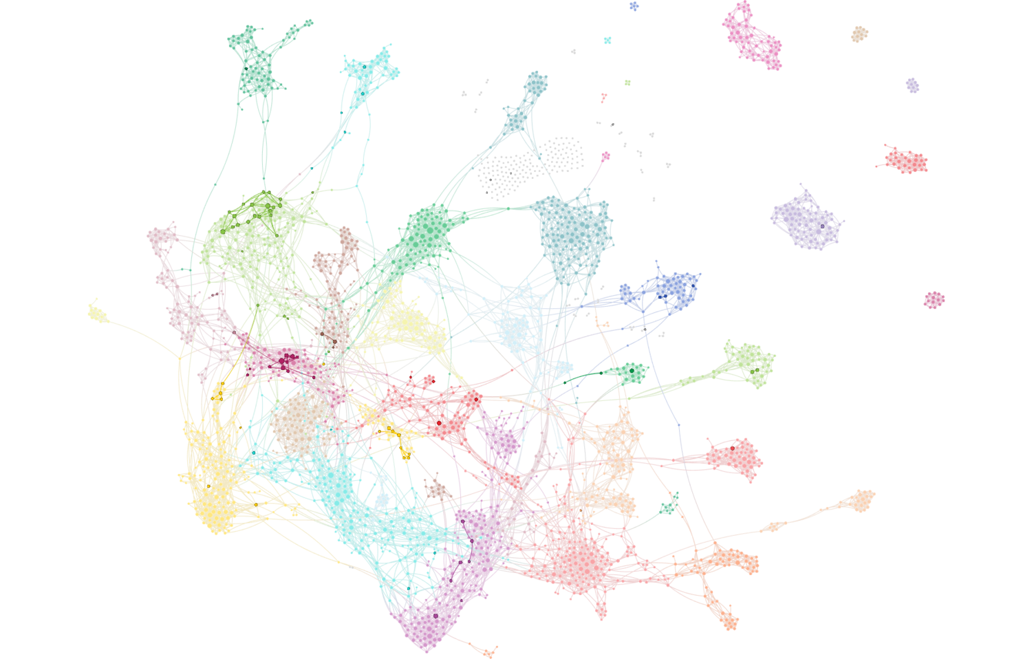
US Fiscal Policy Attention – May 2019
Full network reflects all articles referencing stocks/equities. Bold-faced nodes represent articles discussing fiscal deficits, the US federal budget and national debt matters.

Slide 27
US Fiscal Policy Cohesion Monitor – May 2019

Slide 28
US Fiscal Policy Fiat News Monitor – May 2019

Slide 29
US Fiscal Policy Sentiment Monitor – May 2019

Slide 30
Credit Cycle Commentary
We still see the credit cycle narrative structure as complacent, although anecdotally we have observed increasing expressions of concern in leveraged loans / direct lending / CLO land that aren’t emerging in this analysis. We are examining both sources and query structures to make sure we’re capturing a sufficiently broad base of articles to represent this topic.
Elsewhere, concerns emerging in credit markets appear to be broadly consistent with equity markets, which is to say focused almost exclusively on trade and tariffs issues.
Also similarly to other monitors, we are seeing distinct narratives form around politically sensitive credit areas – in this case, farmers and students are emerging as debt topics of note in financial media coverage.
No material change in sentiment or fiat news levels.

Slide 31
Credit Cycle Network Map – May 2019

Slide 32
Credit Cycle Attention – May 2019
Full network reflects all articles referencing the credit cycle, changes in spreads, liquidity, debt issuance and defaults / delinquencies.

Slide 33
Credit Cycle Cohesion Monitor – May 2019

Slide 34
Credit Cycle Fiat News Monitor – May 2019

Slide 35
Credit Cycle Sentiment Monitor – May 2019

Slide 36
Text Analytics Background

Slide 37
How to Read a Network
Quid creates a visual map to represent the landscape. Example network: sized by degree, colored by cluster.

Slide 38
ET Professional Terminology
Cohesion is an Epsilon Theory-only measure which uses a Djikstra Algorithm to find the shortest distance between each node (article) pair, and measures the normalized harmonic centrality of the entire network of those pairs. Think of it as a measure of the similarity between all articles on a topic. It is measured between 0-1, and should not be compared between topics, which may be naturally more or less similar because of the nature of the topic as defined.
Attention is an Epsilon Theory measure which calculates each node’s centrality from the Cohesion of the broad universe. It then maps those nodes to individual topics (e.g. Inflation or Trade), and calculates whether the number of articles of high influence on the broader financial market network is higher or lower than the historical average for that topic. Attention is scored between -1 and +1, where a positive value indicates that the topic has produced a greater share of central, high influence articles in the broad network than that topic’s historical average.
Sentiment is a Quid-based measure based on scores of the positive or negative characteristics of each n-gram (phrases, words, etc.). Our measure is calculating as (% net positive – % net negative) / (% either positive or negative).
Fiat News is an Epsilon Theory-only measure of the use of words or phrases which communicate assertions of casuality, value judgments or self-evidence (e.g. “obviously”). We use it to measure the aggregate tendency of articles to explain content, which can sometimes be related to periods of heightened narrative promotion.
Narrative Maps are Quid-driven content, but the categories and cluster titles are based on Epsilon Theory analysis of the underlying articles’ content and Quid-identified n-grams.

Slide 39
Disclaimers and Use
This analysis is prepared as general research and commentary, and is not a recommendation to buy or sell any security. It does not take into account individual facts and circumstances, and should be supplemented by additional such analysis to guide any investment decisions.
If you are an ET Professional Subscriber, you may use these slides for personal or commercial use in any client presentation at which the subscriber is present.
In those uses, you may modify the slides to use your branding and format, provided that Epsilon Theory and Quid are described as sources on those pages (footnotes are fine).
You may not distribute these slides publicly (e.g. on Social Media, on your website, etc.) without the permission of Epsilon Theory.

