Slide 1


June 2019
ET Professional Monitors

Slide 2
Contents
Inflation | 3
Central Bank Omnipotence | 10
Trade and Tariffs | 17
US Fiscal Policy | 24
Guide to Use | 30
Disclaimers | 33

Slide 3
Inflation Commentary
We are seeing what we think is a divergence in economic and political narratives of inflation.
  We observe the election and campaigning for the 2020 election rapidly expanding the use powerful inflation language to discuss health care and education costs.
  Meanwhile, we observe almost no coherent discussion about economic measures of inflation, or if anything, an emerging narrative being promoted that rates must be cut in order to spark such inflation.
There is, however, almost no cohesion across central banks on inflation language, and even very little among domestic missionaries. There is no meaningful short-run inflation narrative.
Because of the rise in political affect around specific issues, attention is rising. We would be mindful of portions of the market which may begin to behave as if there is an active inflation narrative on this basis.

Slide 4
Inflation Network Map – June 2019

Slide 5
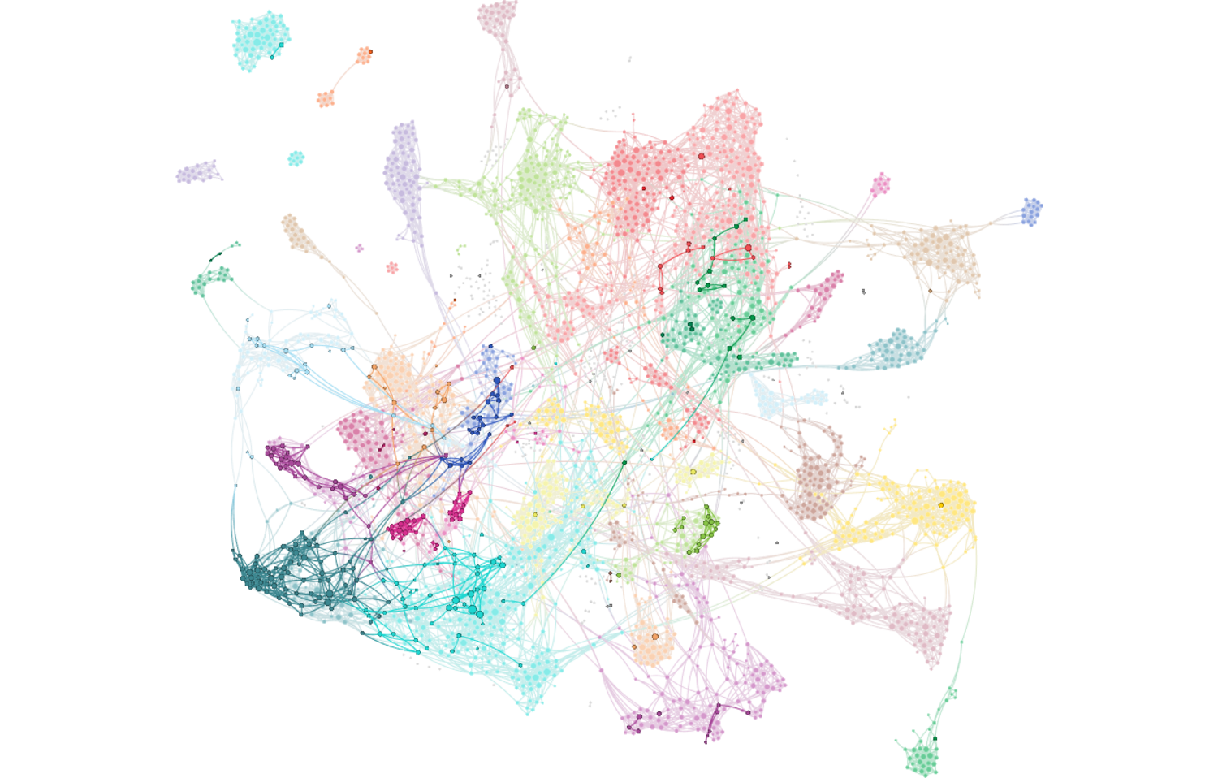
Inflation Attention – June 2019
Full network reflects all articles referencing stocks/equities. Bold-faced nodes represent articles discussing inflation, producer prices, wage pressures and costs.

Slide 6
Inflation Attention Monitor – June 2019

Slide 7
Inflation Cohesion Monitor – June 2019

Slide 8
Inflation Fiat News Monitor – June 2019

Slide 9
Inflation Sentiment Monitor – June 2019

Slide 10
Central Bank Omnipotence Commentary
We have two main observations about the Central Bank Omnipotence narrative:
  There is an emerging, global chorus of “we need to spark inflation” language that has arisen quickly.
  Central Bank and Trade & Tariffs narratives continue to be thoroughly intertwined. We have drums pounding from every central bank that “trade risks” may justify increases.
Both sound to us like strong drum-beating to prep for and justify a rate cut that wouldn’t otherwise be justifiable given stronger-than-expected economic reports.
Separately, we also note that bank regulator activities on liquidity, student debt levels and bank stress tests have become centrally connected to the core of this narrative. Regardless of what actually is the case, a narrative of “it’s time for investors to start thinking seriously about liquidity” IS emerging.

Slide 11
Central Bank Omnipotence Network Map – June 2019

Slide 12
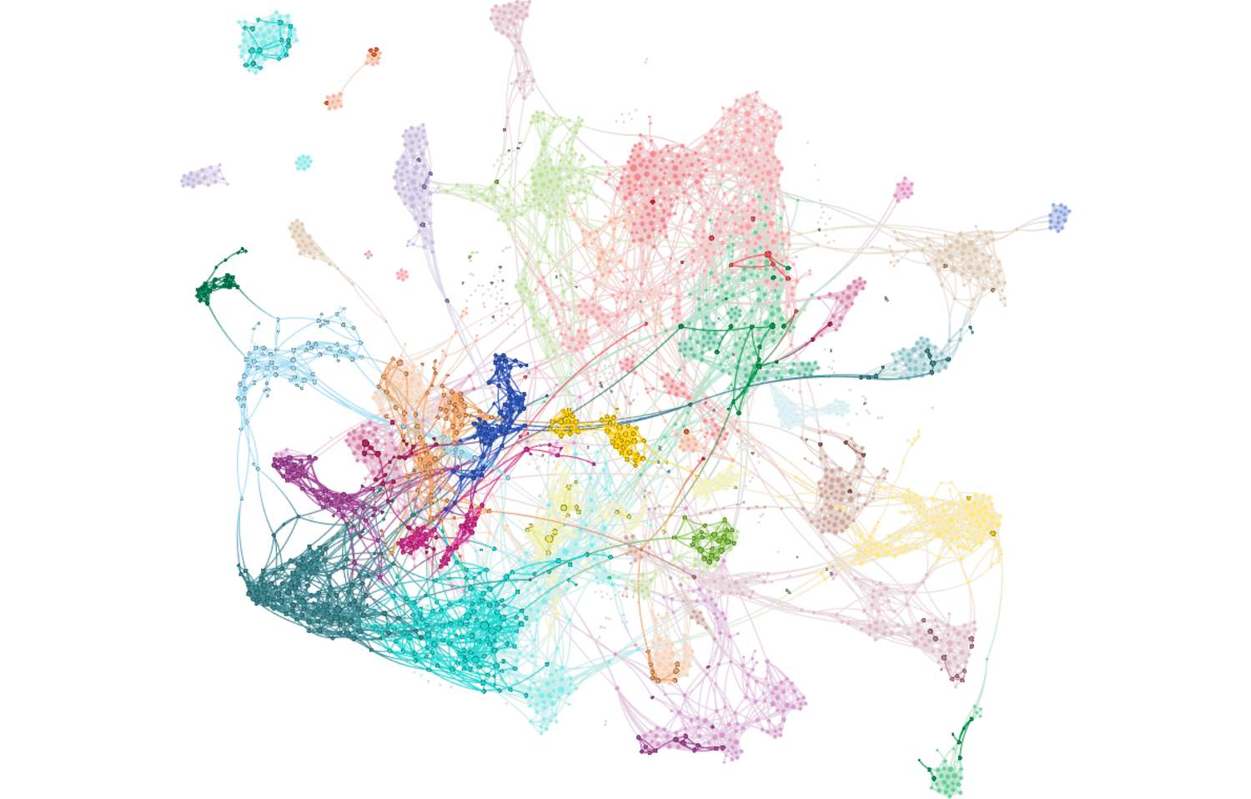
Central Bank Omnipotence Attention – June 2019
Full network reflects all articles referencing stocks/equities. Bold-faced nodes represent articles discussing the Fed, ECB, BOJ, BOE and other global central banking policy.

Slide 13
Central Bank Omnipotence Attention Monitor – June 2019

Slide 14
Central Bank Omnipotence Cohesion Monitor – June 2019

Slide 15
Central Bank Omnipotence Fiat News Monitor – June 2019

Slide 16
Central Bank Omnipotence Sentiment Monitor – June 2019

Slide 17
Trade and Tariffs Commentary
Trade and Tariffs continues to be the dominant narrative; it sits at our maximum attention level for the second straight month.
As with last month’s update, we believe that these narratives are deeply connected to language and narratives about central bank policy and the rationale for expected rate cuts.
The cohesion of these narratives, however, has fallen fairly sharply. We don’t think this means that it isn’t dominating the market’s attention – we think it means that more missionaries are joining the fray to promote their own narrative.
  We are observing a more strident embrace of global narrative promotion by the Chinese.
  We are observing some confusion in US media on how to integrate President Trump’s demands for a rate cut with celebration of the strength of the economy and market (the transformation of US/China into a Political Game is still present, if muted).
  For now, we are not seeing the same existential saber-rattling. It is a short period, so we would not overreact. Still, some aspects of a now-global narrative war begin to look more like a Game of Chicken again. Take risk on their unpredictable outcomes at your own peril.

Slide 18
Trade and Tariffs Network Map – June 2019

Slide 19
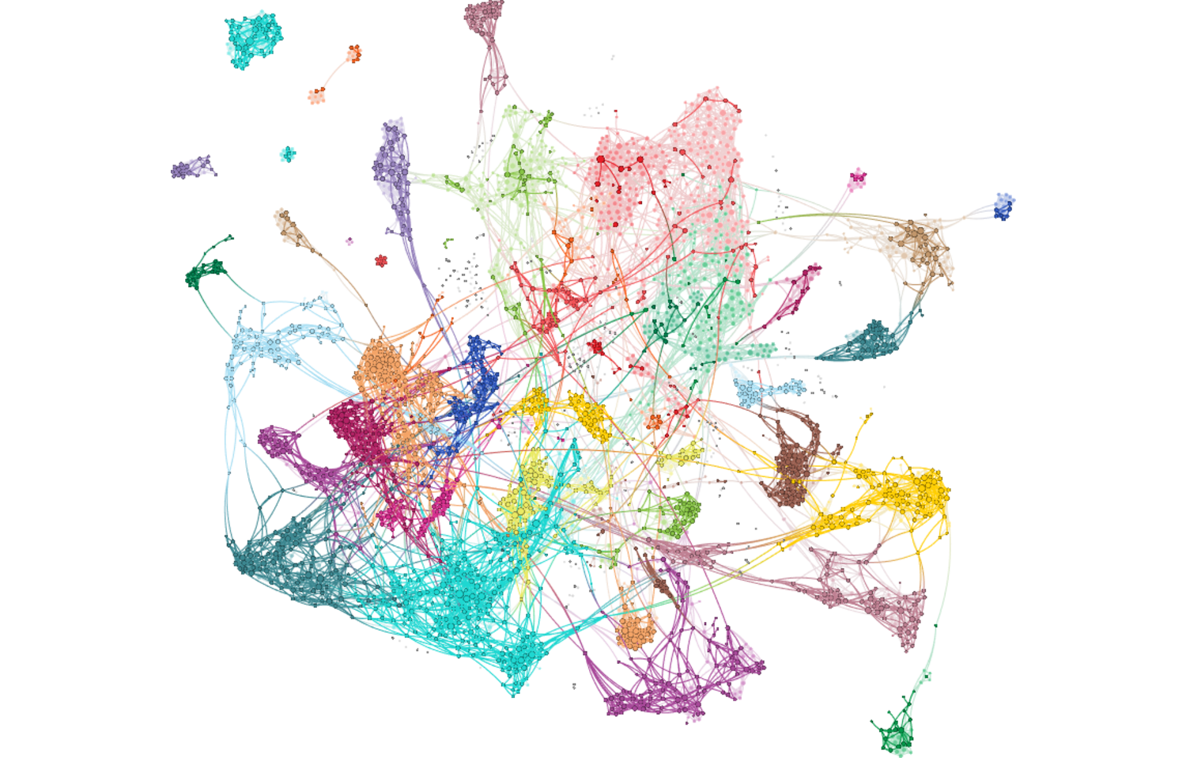
Trade and Tariffs Attention – June 2019
Full network reflects all articles referencing stocks/equities. Bold-faced nodes represent articles discussing trade, tariffs, duties and associated agreements and negotiations.

Slide 20
Trade and Tariffs Attention Monitor – June 2019

Slide 21
Trade and Tariffs Cohesion Monitor – June 2019

Slide 22
Trade and Tariffs Fiat News Monitor – June 2019

Slide 23
Trade and Tariffs Sentiment Monitor – June 2019

Slide 24
US Fiscal Policy Commentary
As in prior months, there is very little attention being paid to fiscal policy / budgetary topics, and practically no linguistic connection between them and financial markets narratives.
Cohesion and Fiat News, too, remain at floor levels.
We counsel some awareness of the scale of policy proposals, especially those being promoted by leading Democratic candidates. The market is paying zero attention with zero cohesion, which we observe as a complacent structure.
A sufficiently credible candidate with a GND/MMT-style approach could be a significant surprise to a market that could not care less about debt ceiling negotiations, government shutdowns, debt levels or budget deficits.

Slide 25
US Fiscal Policy Network Map – June 2019

Slide 26
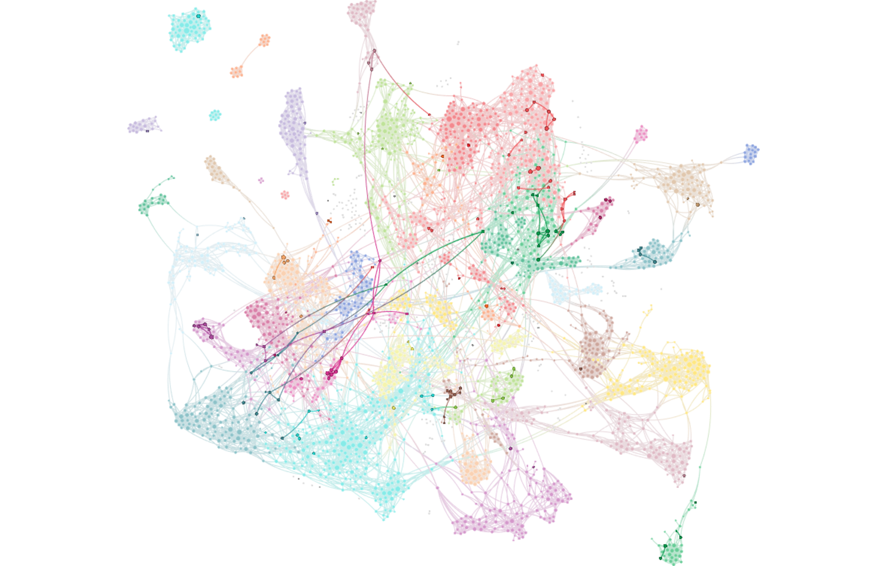
US Fiscal Policy Attention – June 2019
Full network reflects all articles referencing stocks/equities. Bold-faced nodes represent articles discussing fiscal deficits, the US federal budget and national debt matters.

Slide 27
US Fiscal Policy Cohesion Monitor – June 2019

Slide 28
US Fiscal Policy Fiat News Monitor – June 2019

Slide 29
US Fiscal Policy Sentiment Monitor – June 2019

Slide 30
Text Analytics Background

Slide 31
How to Read a Network
Quid creates a visual map to represent the landscape. Example network: sized by degree, colored by cluster.

Slide 32
ET Professional Terminology
Cohesion is an Epsilon Theory-only measure which uses a Djikstra Algorithm to find the shortest distance between each node (article) pair, and measures the normalized harmonic centrality of the entire network of those pairs. Think of it as a measure of the similarity between all articles on a topic. It is measured between 0-1, and should not be compared between topics, which may be naturally more or less similar because of the nature of the topic as defined.
Attention is an Epsilon Theory measure which calculates each node’s centrality from the Cohesion of the broad universe. It then maps those nodes to individual topics (e.g. Inflation or Trade), and calculates whether the number of articles of high influence on the broader financial market network is higher or lower than the historical average for that topic. Attention is scored between -1 and +1, where a positive value indicates that the topic has produced a greater share of central, high influence articles in the broad network than that topic’s historical average.
Sentiment is a Quid-based measure based on scores of the positive or negative characteristics of each n-gram (phrases, words, etc.). Our measure is calculating as (% net positive – % net negative) / (% either positive or negative).
Fiat News is an Epsilon Theory-only measure of the use of words or phrases which communicate assertions of casuality, value judgments or self-evidence (e.g. “obviously”). We use it to measure the aggregate tendency of articles to explain content, which can sometimes be related to periods of heightened narrative promotion.
Narrative Maps are Quid-driven content, but the categories and cluster titles are based on Epsilon Theory analysis of the underlying articles’ content and Quid-identified n-grams.

Slide 33
Disclaimers and Use
This analysis is prepared as general research and commentary, and is not a recommendation to buy or sell any security. It does not take into account individual facts and circumstances, and should be supplemented by additional such analysis to guide any investment decisions.
If you are an ET Professional Subscriber, you may use these slides for personal or commercial use in any client presentation at which the subscriber is present.
In those uses, you may modify the slides to use your branding and format, provided that Epsilon Theory and Quid are described as sources on those pages (footnotes are fine).
You may not distribute these slides publicly (e.g. on Social Media, on your website, etc.) without the permission of Epsilon Theory.

