Slide 1


July 2019
ET Professional Monitors

Slide 2
Contents
Inflation | 3
Central Bank Omnipotence | 10
Trade and Tariffs | 17
US Fiscal Policy | 24
Guide to Use | 30
Disclaimers | 33

Slide 3
Inflation Commentary
Already paltry attention to inflation narratives eroded further in July, with almost no focus from major financial media or market participants.
Cohesion likewise remains at low levels. There is no single story being told and repeated about inflation.
To the contrary, there is tremendous topical and linguistic divergence in discussions of inflation.
  There remains a powerful and persistent political narrative around localized costs of drugs, education and health care.
  There is also a persistent narrative around the absence of wage inflation.
We would describe this as the current, complacent narrative structure: “There is no inflation, we expect no inflation, and it isn’t influencing markets.”

Slide 4
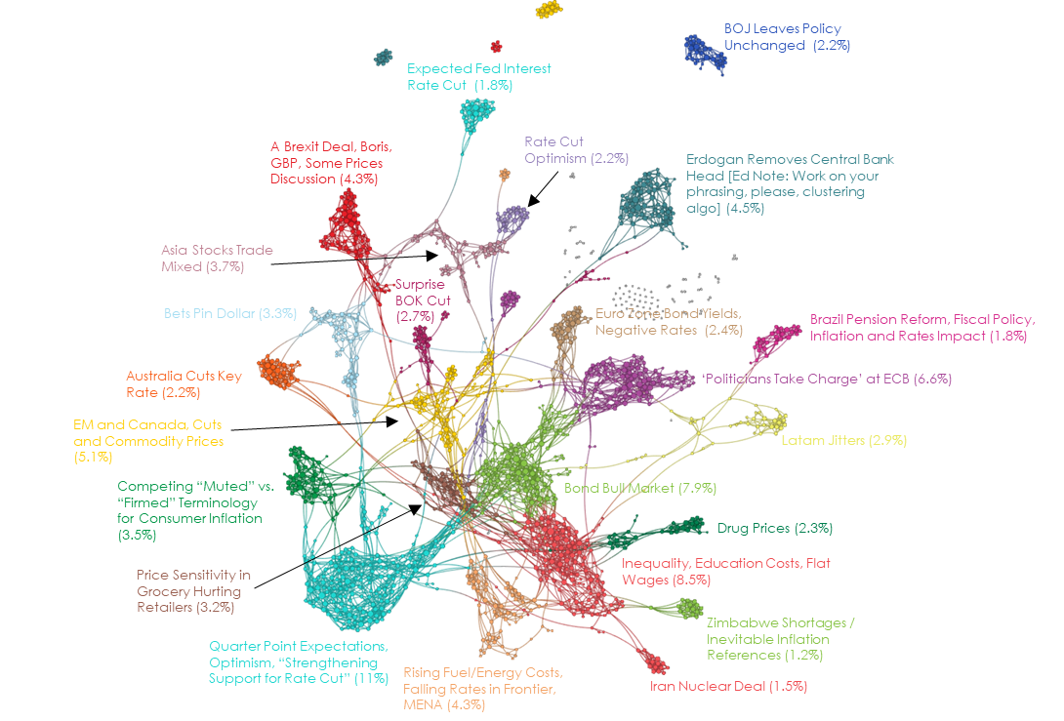
Inflation Network Map – July 2019

Slide 5
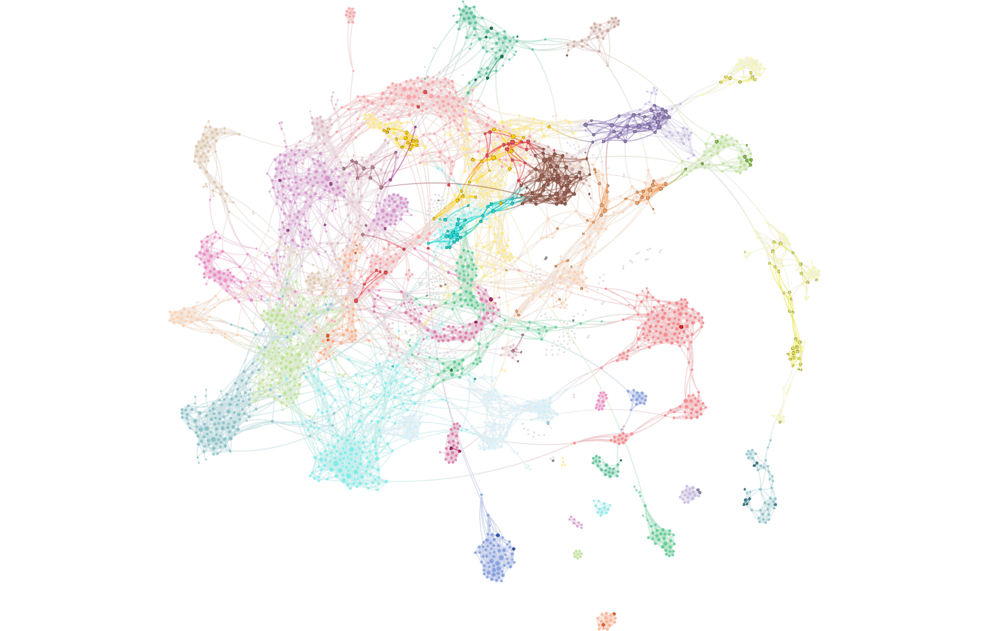
Inflation Attention – July 2019
Full network reflects all articles referencing stocks/equities. Bold-faced nodes represent articles discussing inflation, producer prices, wage pressures and costs.

Slide 6
Inflation Attention Monitor – July 2019

Slide 7
Inflation Cohesion Monitor – July 2019

Slide 8
Inflation Fiat News Monitor – July 2019

Slide 9
Inflation Sentiment Monitor – July 2019

Slide 10
Central Bank Omnipotence Commentary
As expectations of a US rate cut became unanimous into late July, attention to central bank omnipotence narratives actually fell slightly from our June measure.
To be clear, the volume of central bank coverage increased substantially, but the language used to discuss markets began to diverge from this language.
Sometimes this takes place because of complacency – attention falls because common knowledge treats it as self-evident – but we don’t think that’s what happened here.
As we have discussed the last few months, we think that central bank narratives have begun to integrate with trade narratives in some ways that have caused pure “Fed put” discussions to fade to the background.
The narrative of central banks is not just “puts on financial markets” – the narrative is increasingly “tool of currency wars”, a shift that has also reduced cohesion of these narratives. It hasn’t darkened our view of the common knowledge in the Fed/ECB/Central Bank put – yet.

Slide 11
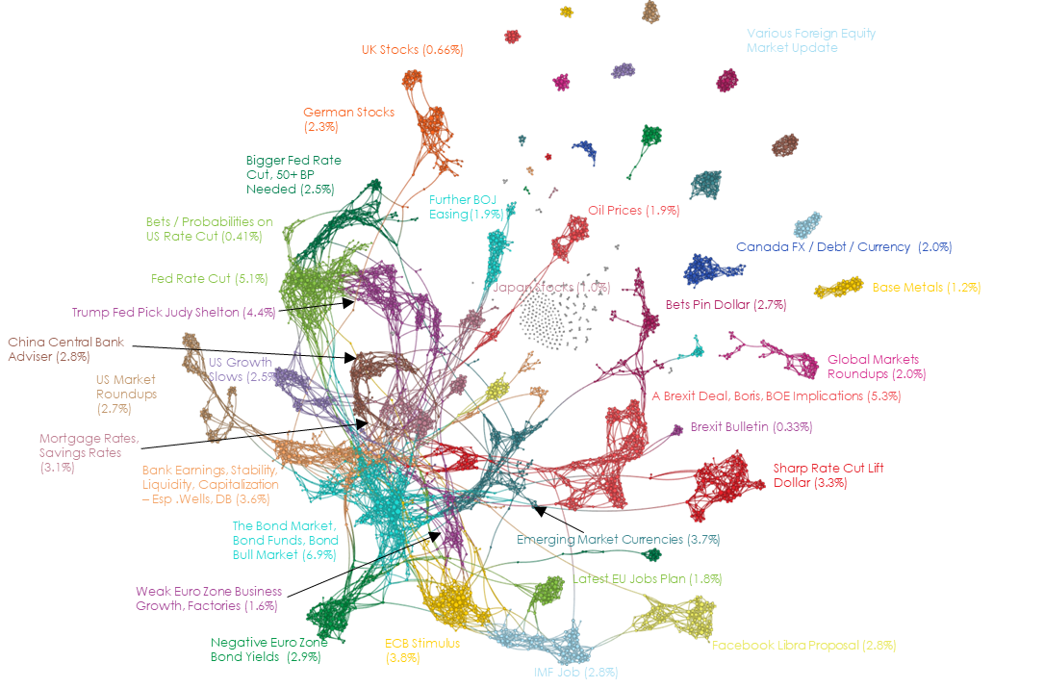
Central Bank Omnipotence Network Map – July 2019

Slide 12
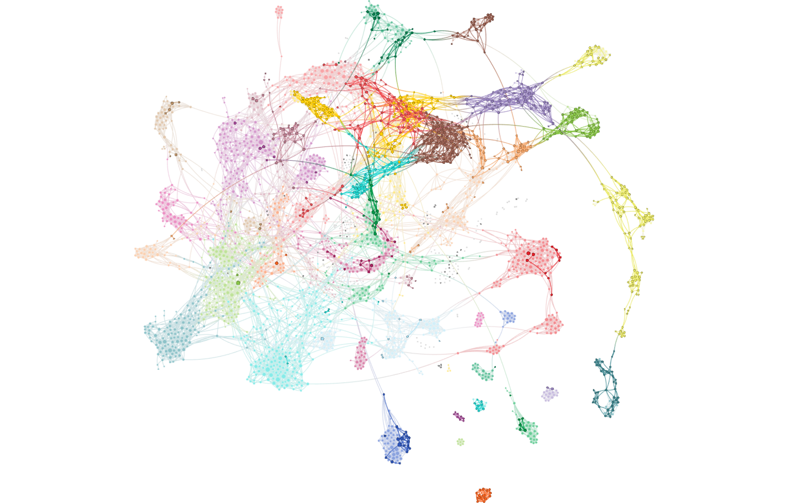
Central Bank Omnipotence Attention – July 2019
Full network reflects all articles referencing stocks/equities. Bold-faced nodes represent articles discussing the Fed, ECB, BOJ, BOE and other global central banking policy.

Slide 13
Central Bank Omnipotence Attention Monitor – July 2019

Slide 14
Central Bank Omnipotence Cohesion Monitor – July 2019

Slide 15
Central Bank Omnipotence Fiat News Monitor – July 2019

Slide 16
Central Bank Omnipotence Sentiment Monitor – July 2019

Slide 17
Trade and Tariffs Commentary
Three things happened to Trade and Tariffs narratives in July, leading up to a rather eventful start to August:
  Attention remained at record high levels under our measure. The supreme importance of the Trade War remains THE market narrative.
  Sentiment rose, as expectations of a thawing / cooperative resolution generally strengthened.
  Cohesion continued its fall, as (1) new voices, including Chinese perspectives, entered the fray with different narratives and (2) topics veered toward Brexit and US/EU trade issues.
The result was that, while by no means complacent, markets entered August with what we think was a more-confident-than-warranted view of the general direction of the US/China Trade War, which remains a Game of Chicken.
We recommend reviewing Ben’s brief note sent on Monday, August 5th for our views updated following the early month volatility.

Slide 18
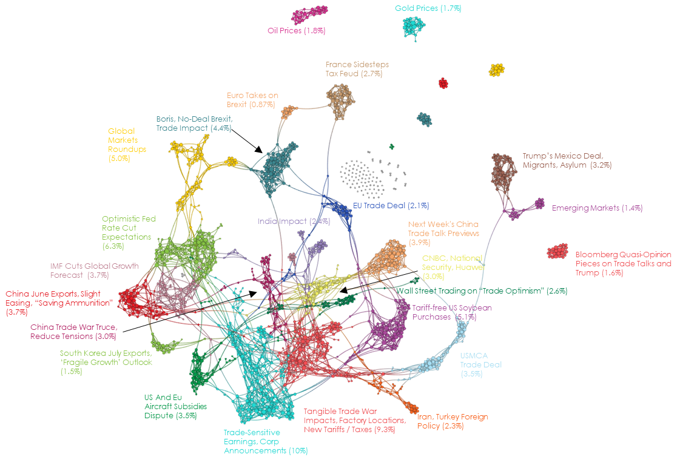
Trade and Tariffs Network Map – July 2019

Slide 19
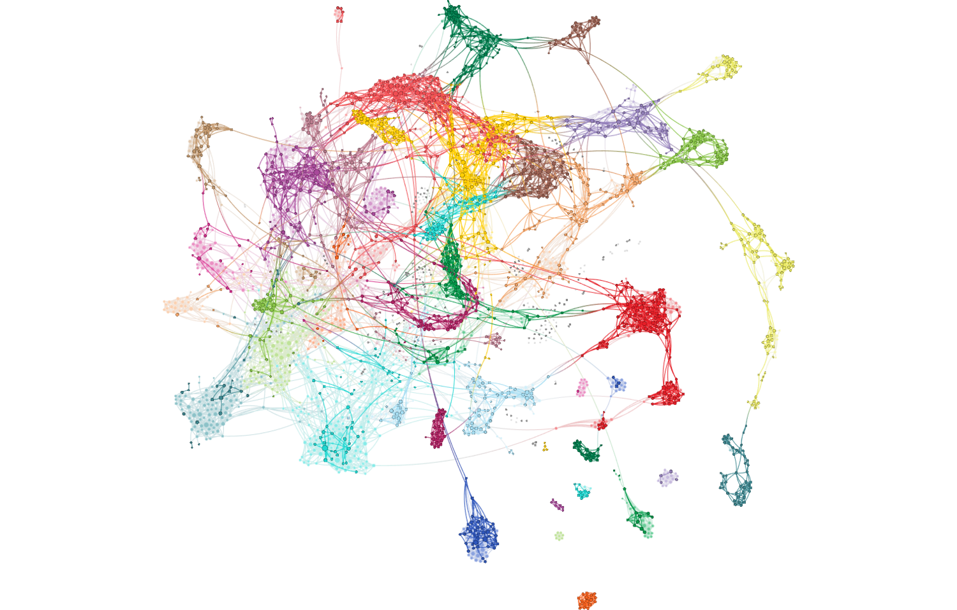
Trade and Tariffs Attention – July 2019
Full network reflects all articles referencing stocks/equities. Bold-faced nodes represent articles discussing trade, tariffs, duties and associated agreements and negotiations.

Slide 20
Trade and Tariffs Attention Monitor – July 2019

Slide 21
Trade and Tariffs Cohesion Monitor – July 2019

Slide 22
Trade and Tariffs Fiat News Monitor – July 2019

Slide 23
Trade and Tariffs Sentiment Monitor – July 2019

Slide 24
US Fiscal Policy Commentary
There is no Fiscal Policy, Deficit or Austerity narrative, except perhaps the narrative that these things “no longer matter’
  European financial media are actively writing with grief about the austerity programs put in place in Greece, for example.
The brief cohesion bump from the 2018 election and early primary platform discussions has since fallen to floor levels.
Likewise, the positive sentiment attached to stories about MMT, Green New deal and social safety net expansions has fallen away with the fading popularity of those articles.
We accordingly think that investment theses based on fiscal policy, budgets or government debt levels would need very powerful catalysts to be investable.

Slide 25
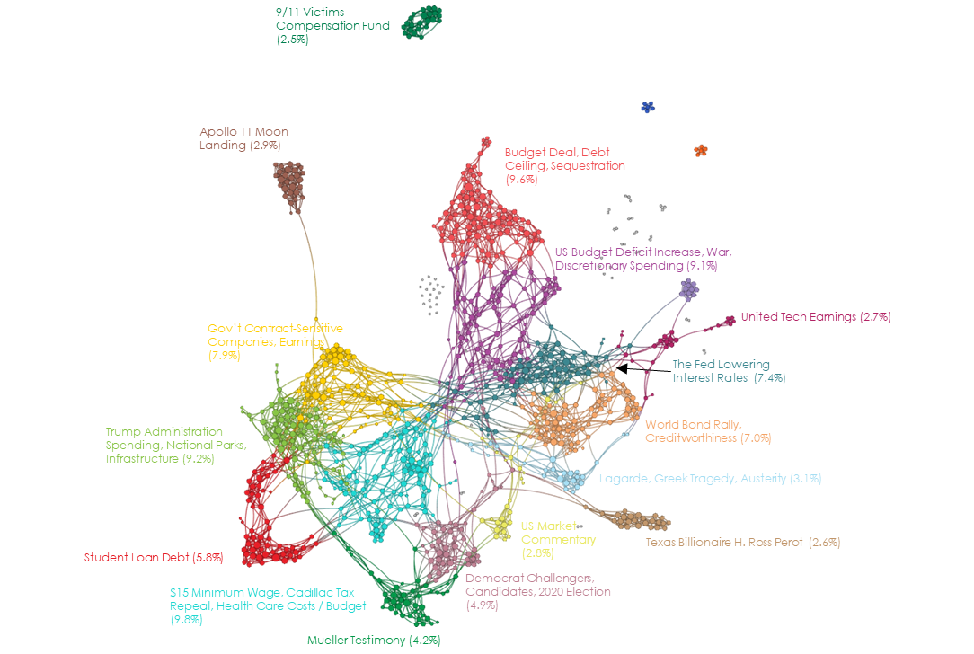
US Fiscal Policy Network Map – July 2019

Slide 26
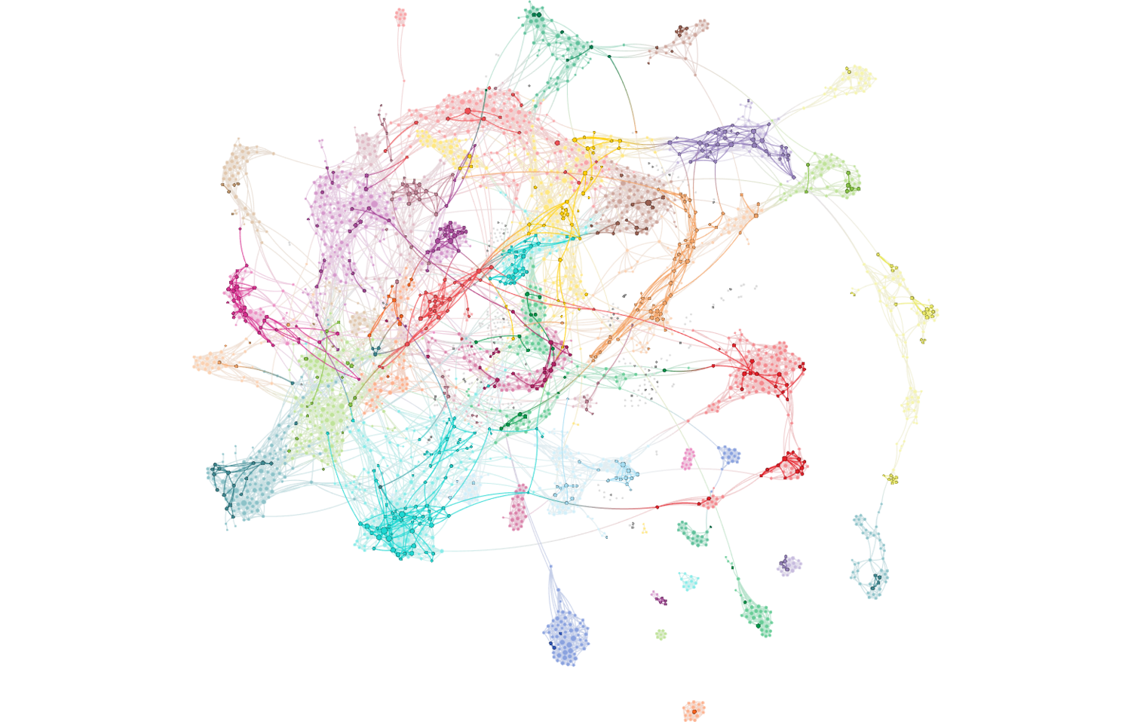
US Fiscal Policy Attention – July 2019
Full network reflects all articles referencing stocks/equities. Bold-faced nodes represent articles discussing fiscal deficits, the US federal budget and national debt matters.

Slide 27
US Fiscal Policy Cohesion Monitor – July 2019

Slide 28
US Fiscal Policy Fiat News Monitor – July 2019

Slide 29
US Fiscal Policy Sentiment Monitor – July 2019

Slide 30
Text Analytics Background

Slide 31
How to Read a Network
Quid creates a visual map to represent the landscape. Example network: sized by degree, colored by cluster.

Slide 32
ET Professional Terminology
Cohesion is an Epsilon Theory-only measure which uses a Djikstra Algorithm to find the shortest distance between each node (article) pair, and measures the normalized harmonic centrality of the entire network of those pairs. Think of it as a measure of the similarity between all articles on a topic. It is measured between 0-1, and should not be compared between topics, which may be naturally more or less similar because of the nature of the topic as defined.
Attention is an Epsilon Theory measure which calculates each node’s centrality from the Cohesion of the broad universe. It then maps those nodes to individual topics (e.g. Inflation or Trade), and calculates whether the number of articles of high influence on the broader financial market network is higher or lower than the historical average for that topic. Attention is scored between -1 and +1, where a positive value indicates that the topic has produced a greater share of central, high influence articles in the broad network than that topic’s historical average.
Sentiment is a Quid-based measure based on scores of the positive or negative characteristics of each n-gram (phrases, words, etc.). Our measure is calculating as (% net positive – % net negative) / (% either positive or negative).
Fiat News is an Epsilon Theory-only measure of the use of words or phrases which communicate assertions of casuality, value judgments or self-evidence (e.g. “obviously”). We use it to measure the aggregate tendency of articles to explain content, which can sometimes be related to periods of heightened narrative promotion.
Narrative Maps are Quid-driven content, but the categories and cluster titles are based on Epsilon Theory analysis of the underlying articles’ content and Quid-identified n-grams.

Slide 33
Disclaimers and Use
This analysis is prepared as general research and commentary, and is not a recommendation to buy or sell any security. It does not take into account individual facts and circumstances, and should be supplemented by additional such analysis to guide any investment decisions.
If you are an ET Professional Subscriber, you may use these slides for personal or commercial use in any client presentation at which the subscriber is present.
In those uses, you may modify the slides to use your branding and format, provided that Epsilon Theory and Quid are described as sources on those pages (footnotes are fine).
You may not distribute these slides publicly (e.g. on Social Media, on your website, etc.) without the permission of Epsilon Theory.

