Slide 1
December 2019
ET Professional Monitors

Slide 2
Contents
Inflation | 3
Central Bank Omnipotence | 11
Trade and Tariffs | 19
US Recession | 27
US Fiscal Policy | 35
Credit and Debt | 42
Guide to Use | 49
Disclaimers | 51

Slide 3
Inflation Commentary
All of our macro themes remain at depressed levels of cohesion and attention – in short, we think that risky asset markets are operating without a dominant narrative.
However, there was a notable pickup – early drumbeats – in common knowledge about inflation in December.
We think the fairly sharp moves (relative to recent history) in precious metals and some commodities, for example, are indicative of the influence of a complacent narrative structure in the presence of even limited new information.
We have no fundamental thesis regarding inflation whatsoever. We have no idea if it is coming.
Nevertheless, we would expect similarly disproportionate impact from new information (in both directions, but especially favoring inflation) given the continued complacency.

Slide 4
Inflation Network Map – December 2019

Slide 5
Inflation Sentiment Map – December 2019

Slide 6
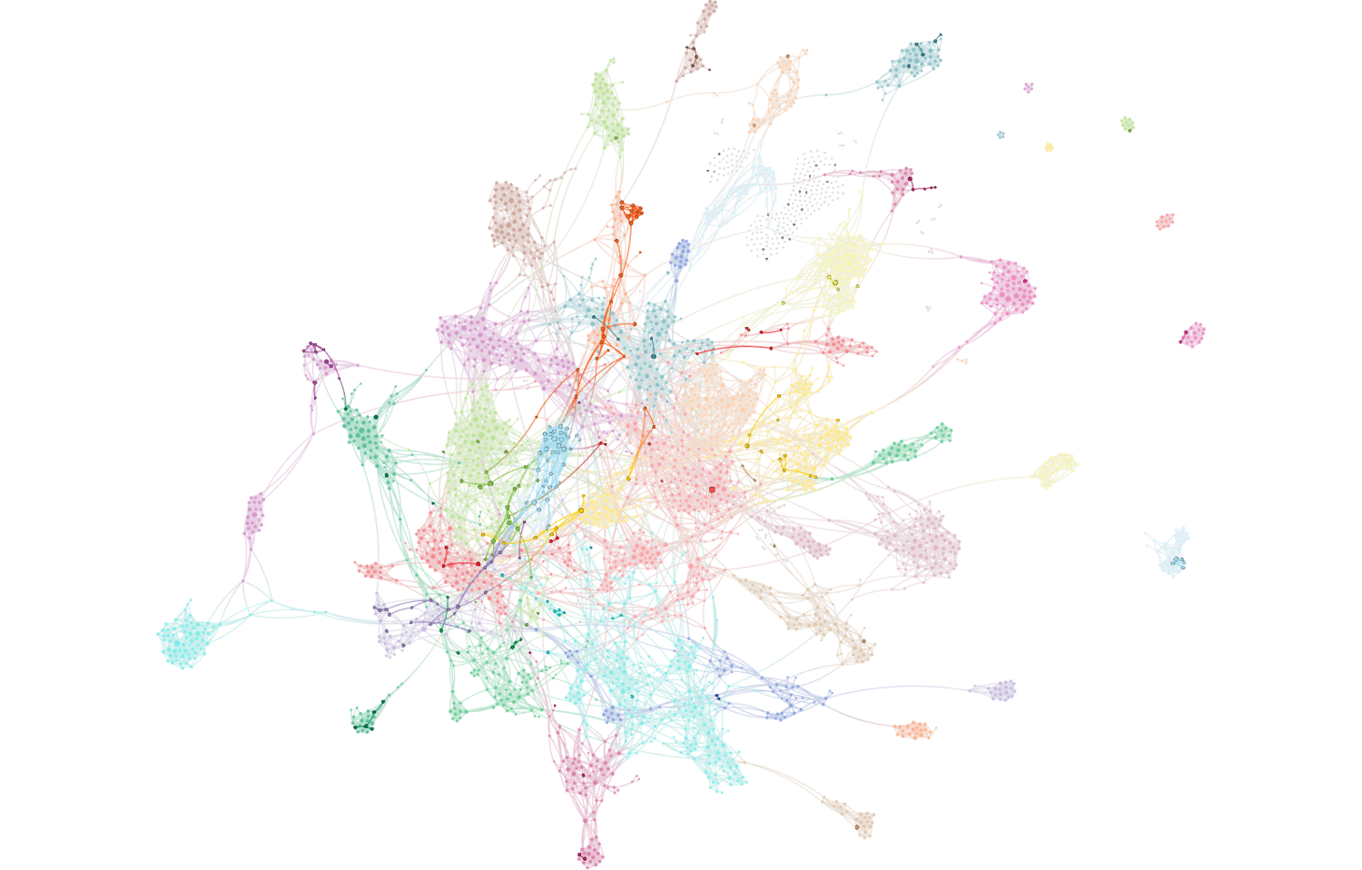
Inflation Attention – December 2019
Full network reflects all articles referencing stocks/equities. Bold-faced nodes represent articles discussing inflation, producer prices, wage pressures and costs.

Slide 7
Inflation Attention Monitor – December 2019

Slide 8
Inflation Cohesion Monitor – December 2019

Slide 9
Inflation Fiat News Monitor – December 2019

Slide 10
Inflation Sentiment Monitor – December 2019

Slide 11
Central Bank Omnipotence Commentary
As with the other macro narratives we track central bank narratives have become highly diluted relative to prior periods, we think in large part as a result of the emergence of a wide variety of additional macro questions attracting moderate levels of competing attention.
Part of the muddling in cohesion relates to a real divergence in central banking discussions, a surprising quantity of which has begun wandering into topics like climate change and central banks’ role (?) in addressing it.
As with our November update, we continue to see a moderate linkage between the Trade War and “necessary” policy response.
We still think there is a long-cycle narrative of Central Bank Omnipotence – that the Fed will step in if needed on rates, and that doing so will be effective w/r/t asset prices - but there is no question that it is muddled in the short run.
Given this narrative structure, we would generally expect greater than expected response to either positive or negative surprise on interest rate policy or associated language.

Slide 12
Central Bank Omnipotence Network Map – December 2019

Slide 13
Central Bank Omnipotence Sentiment Map – December 2019

Slide 14
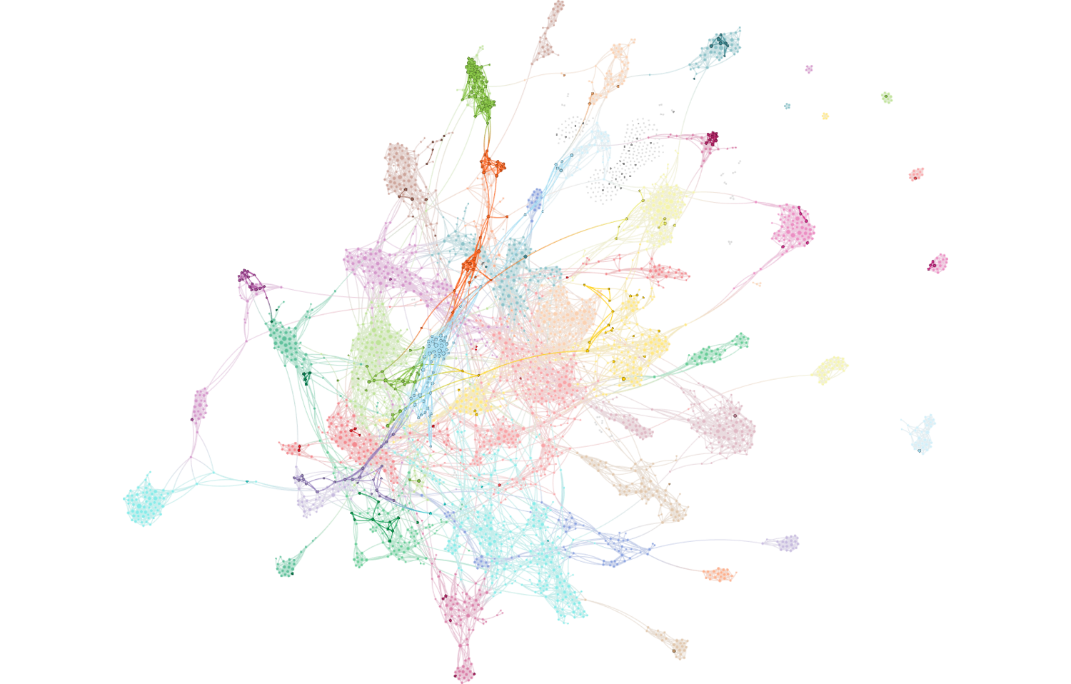
Central Bank Omnipotence Attention – December 2019
Full network reflects all articles referencing stocks/equities. Bold-faced nodes represent articles discussing the Fed, ECB, BOJ, BOE and other global central banking policy.

Slide 15
Central Bank Omnipotence Attention Monitor – December 2019

Slide 16
Central Bank Omnipotence Cohesion Monitor – December 2019

Slide 17
Central Bank Omnipotence Fiat News Monitor – December 2019

Slide 18
Central Bank Omnipotence Sentiment Monitor – December 2019

Slide 19
Trade and Tariffs Commentary
Despite the recent erosion in attention and cohesion across all macro themes, we think it remains Common Knowledge that the Trade War is what matters to risky asset markets.
Most of the erosion in cohesion is related to changes in topical language rather than changes in tone. Trade commentary is increasingly focused on USMCA, France and Brexit as opposed to China, where there have been fewer recent developments.
The most central clusters have become more cohesive around a focus on autos, energy technology (esp. solar) and aerospace. Agriculture, consumer products and other equipment are less central to overall trade and tariffs narratives.
We still see very little of the existential / military language we see as a canary for a transition of this Game of Chicken to a more predictable political game. Accordingly we do not favor significant active risk positions on Trade and Tariffs views.

Slide 20
Trade and Tariffs Network Map – December 2019

Slide 21
Trade and Tariffs Sentiment Map – December 2019

Slide 22
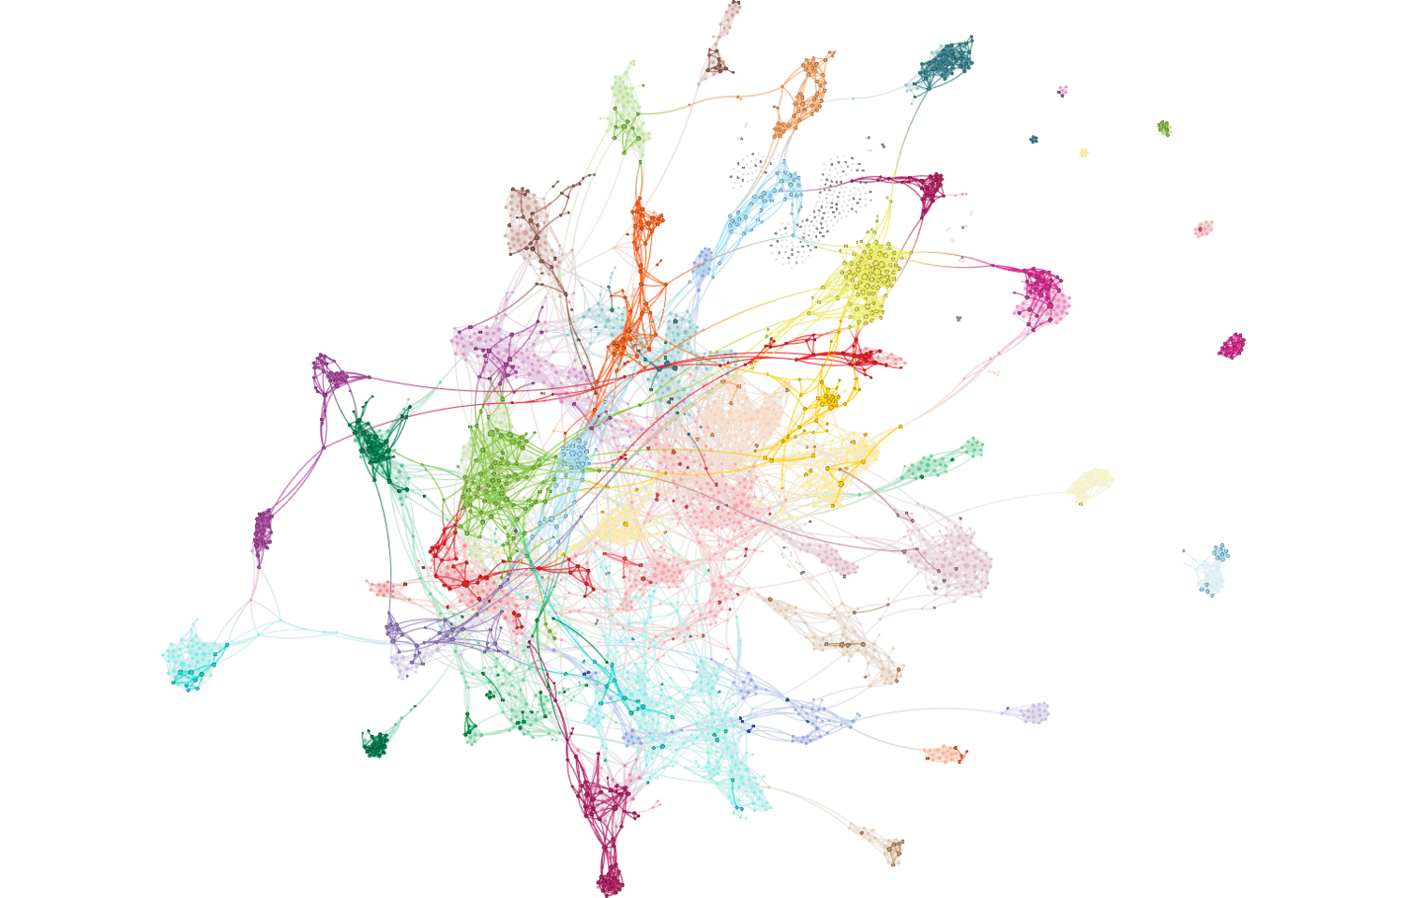
Trade and Tariffs Attention – December 2019
Full network reflects all articles referencing stocks/equities. Bold-faced nodes represent articles discussing trade, tariffs, duties and associated agreements and negotiations.

Slide 23
Trade and Tariffs Attention Monitor – December 2019

Slide 24
Trade and Tariffs Cohesion Monitor – December 2019

Slide 25
Trade and Tariffs Fiat News Monitor – December 2019

Slide 26
Trade and Tariffs Sentiment Monitor – December 2019

Slide 27
US Recession Commentary
Any narrative about a US Recession at this point is complacent and confident about its absence as a risk to equity markets.
The sentiment of articles has risen sharply - as cohesion and attention have fallen – to pre-Summer levels before recession concerns had become a somewhat mainstream media topic.
Even more than in prior periods, focus of even US markets commentary relating to recession has instead focused on recession risks in foreign markets, where the narrative is not quite as complacent.
The result is a muddled narrative structure with some lingering concern about German manufacturing, scattered emerging markets worries and articles asserting that the risk of American recession has passed.
We have no fundamental view on recession risks but believe the complacency may create asymmetric opportunities for investors and allocators with more substantive concerns about the US economy.

Slide 28
US Recession Network Map – December 2019

Slide 29
US Recession Sentiment Map – December 2019

Slide 30
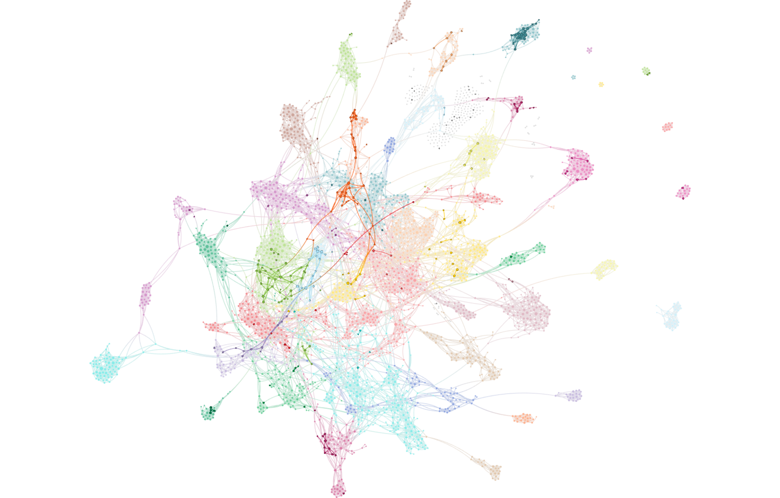
US Recession Attention – December 2019
Full network reflects all articles referencing stocks/equities. Bold-faced nodes represent articles discussing trade, tariffs, duties and associated agreements and negotiations.

Slide 31
US Recession Attention Monitor – December 2019

Slide 32
US Recession Cohesion Monitor – December 2019

Slide 33
US Recession Fiat News Monitor – December 2019

Slide 34
US Recession Sentiment Monitor – December 2019

Slide 35
US Fiscal Policy Commentary
No change in our view for several months: there is no Fiscal Policy, Deficit or Austerity narrative: “We are all MMTers now.”
Our only noteworthy and novel observation is that the cluster of articles referring to socialism, billionaires and investor fears about wealth taxes has become somewhat more central to the overall network.

Slide 36
US Fiscal Policy Network Map – December 2019

Slide 37
US Fiscal Policy Sentiment Map – December 2019

Slide 38

US Fiscal Policy Attention – December 2019
Full network reflects all articles referencing stocks/equities. Bold-faced nodes represent articles discussing fiscal deficits, the US federal budget and national debt matters.

Slide 39
US Fiscal Policy Cohesion Monitor – December 2019

Slide 40
US Fiscal Policy Fiat News Monitor – December 2019

Slide 41
US Fiscal Policy Sentiment Monitor – December 2019

Slide 42
Debt and Credit Commentary
The Q4 narratives promoting the idea of a ‘coming collapse’ in credit markets precipitated by leveraged loan markets has faded somewhat in attention and cohesion.
Sentiment, likewise, has continued to improve.
The language of fear of a credit market collapse continues to exist – ‘vulnerable’, ‘financial stability risk’ and ‘illiquidity’ continue to define some topical clusters, but they are peripheral and have become more so over the last several weeks.
The more central narrative structure exists around issuance, new fund launches and asset owner transitions of asset allocation to direct lending and private credit mandates.

Slide 43
Debt and Credit Network Map – December 2019

Slide 44
Debt and Credit Sentiment Map – December 2019

Slide 45
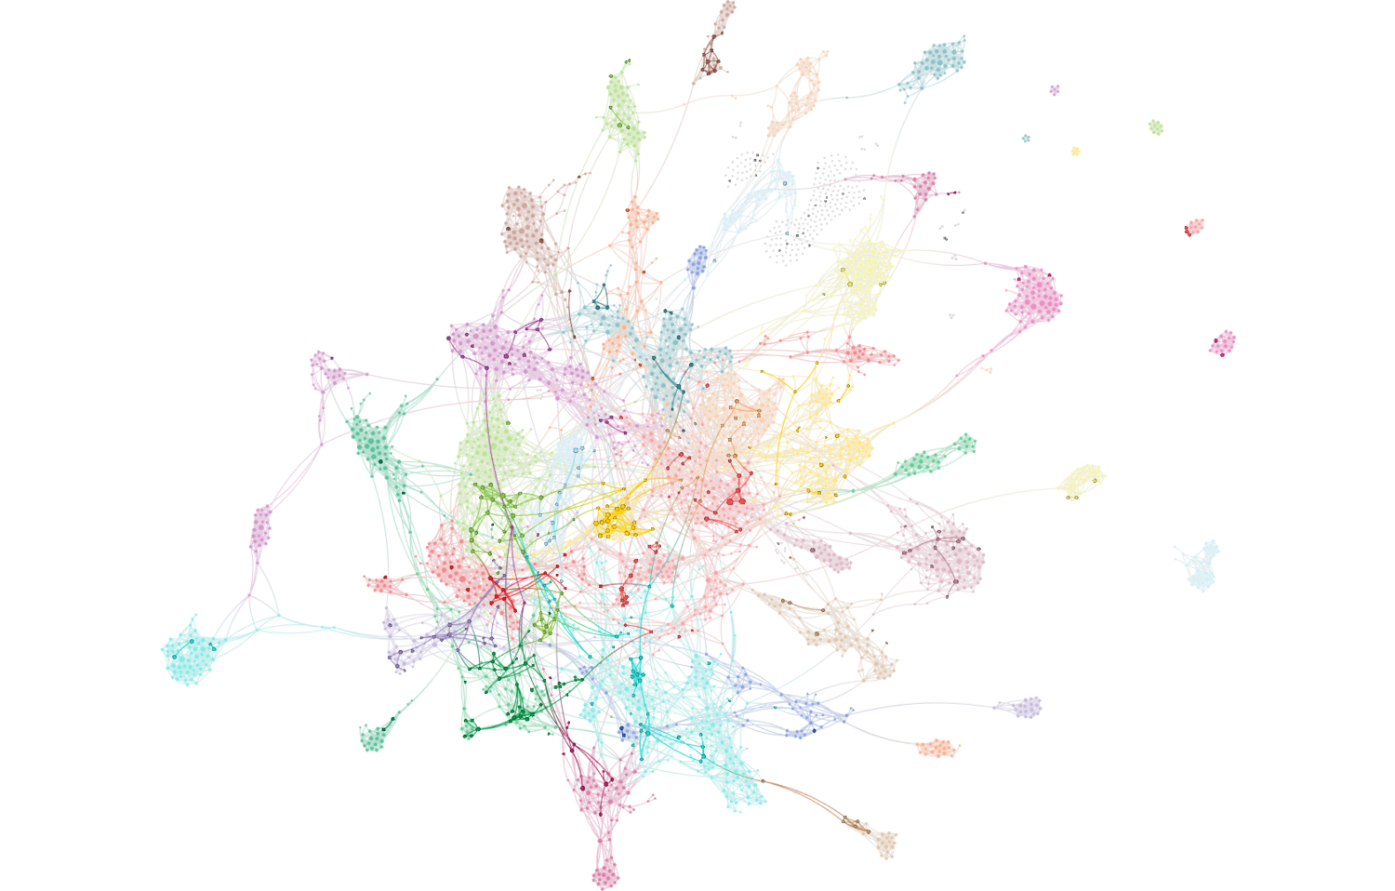
Debt and Credit Attention – December 2019
Full network reflects all articles referencing stocks/equities. Bold-faced nodes represent articles discussing credit, debt and defaults and their influence on risky asset markets.

Slide 46
Debt and Credit Cohesion Monitor – December 2019

Slide 47
Debt and Credit Fiat News Monitor – December 2019

Slide 48
Debt and Credit Sentiment Monitor – December 2019

Slide 49
Text Analytics Background

Slide 50
ET Professional Terminology
Cohesion is an Epsilon Theory-only measure which uses a Djikstra Algorithm to find the shortest distance between each node (article) pair, and measures the normalized harmonic centrality of the entire network of those pairs. Think of it as a measure of the similarity between all articles on a topic. It is measured between 0-1, and should not be compared between topics, which may be naturally more or less similar because of the nature of the topic as defined.
Attention is an Epsilon Theory measure which calculates each node’s centrality from the Cohesion of the broad universe. It then maps those nodes to individual topics (e.g. Inflation or Trade), and calculates whether the number of articles of high influence on the broader financial market network is higher or lower than the historical average for that topic. Attention is scored between -1 and +1, where a positive value indicates that the topic has produced a greater share of central, high influence articles in the broad network than that topic’s historical average.
Sentiment is a Quid-based measure based on scores of the positive or negative characteristics of each n-gram (phrases, words, etc.). Our measure is calculating as (% net positive – % net negative) / (% either positive or negative).
Fiat News is an Epsilon Theory-only measure of the use of words or phrases which communicate assertions of casuality, value judgments or self-evidence (e.g. “obviously”). We use it to measure the aggregate tendency of articles to explain content, which can sometimes be related to periods of heightened narrative promotion.
Narrative Maps are Quid-driven content, but the categories and cluster titles are based on Epsilon Theory analysis of the underlying articles’ content and Quid-identified n-grams.

Slide 51
Disclaimers and Use
This analysis is prepared as general research and commentary, and is not a recommendation to buy or sell any security. It does not take into account individual facts and circumstances, and should be supplemented by additional such analysis to guide any investment decisions.
If you are an ET Professional Subscriber, you may use these slides for personal or commercial use in any client presentation at which the subscriber is present.
In those uses, you may modify the slides to use your branding and format, provided that Epsilon Theory and Quid are described as sources on those pages (footnotes are fine).
You may not distribute these slides publicly (e.g. on Social Media, on your website, etc.) without the permission of Epsilon Theory.

